Slide 1
Introduction to LangGraph for Building AI Agents
March 2025 Workshop
Dipanjan (DJ) Sarkar

Slide 2
Workshop Guidelines
Assumptions: Python essentials + Introduction to LangChain (good to know)
Session will cover concepts and hands-on code demos
Please type your questions in the chat \ QA tab
Will address questions at regular intervals + at the end
Please ask queries related to today’s session only
Queries on other issues, access problems, course issues etc reach out to the support team
Each workshop will be repeated per quarter over the year
Slides, notebook links, recording will be uploaded and shared in the LMS by next week
Use the workshops to augment and supplement your learning, not as a replacement of the courses in the program

Slide 3
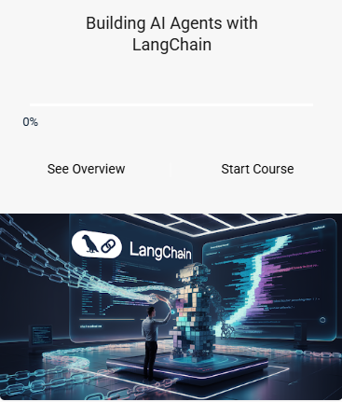
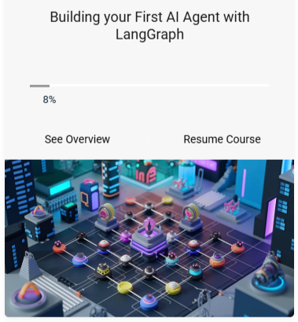
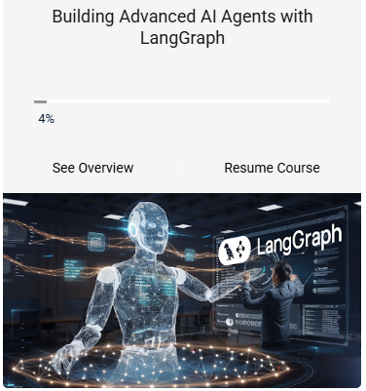
Useful Courses to go through

Slide 4
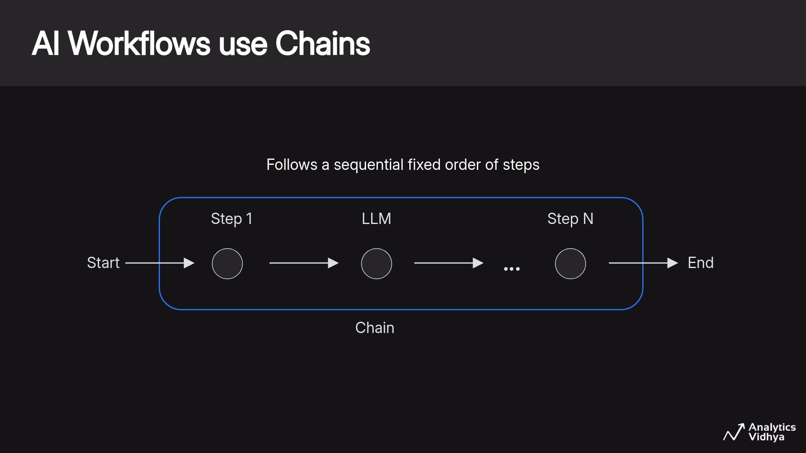

Slide 5
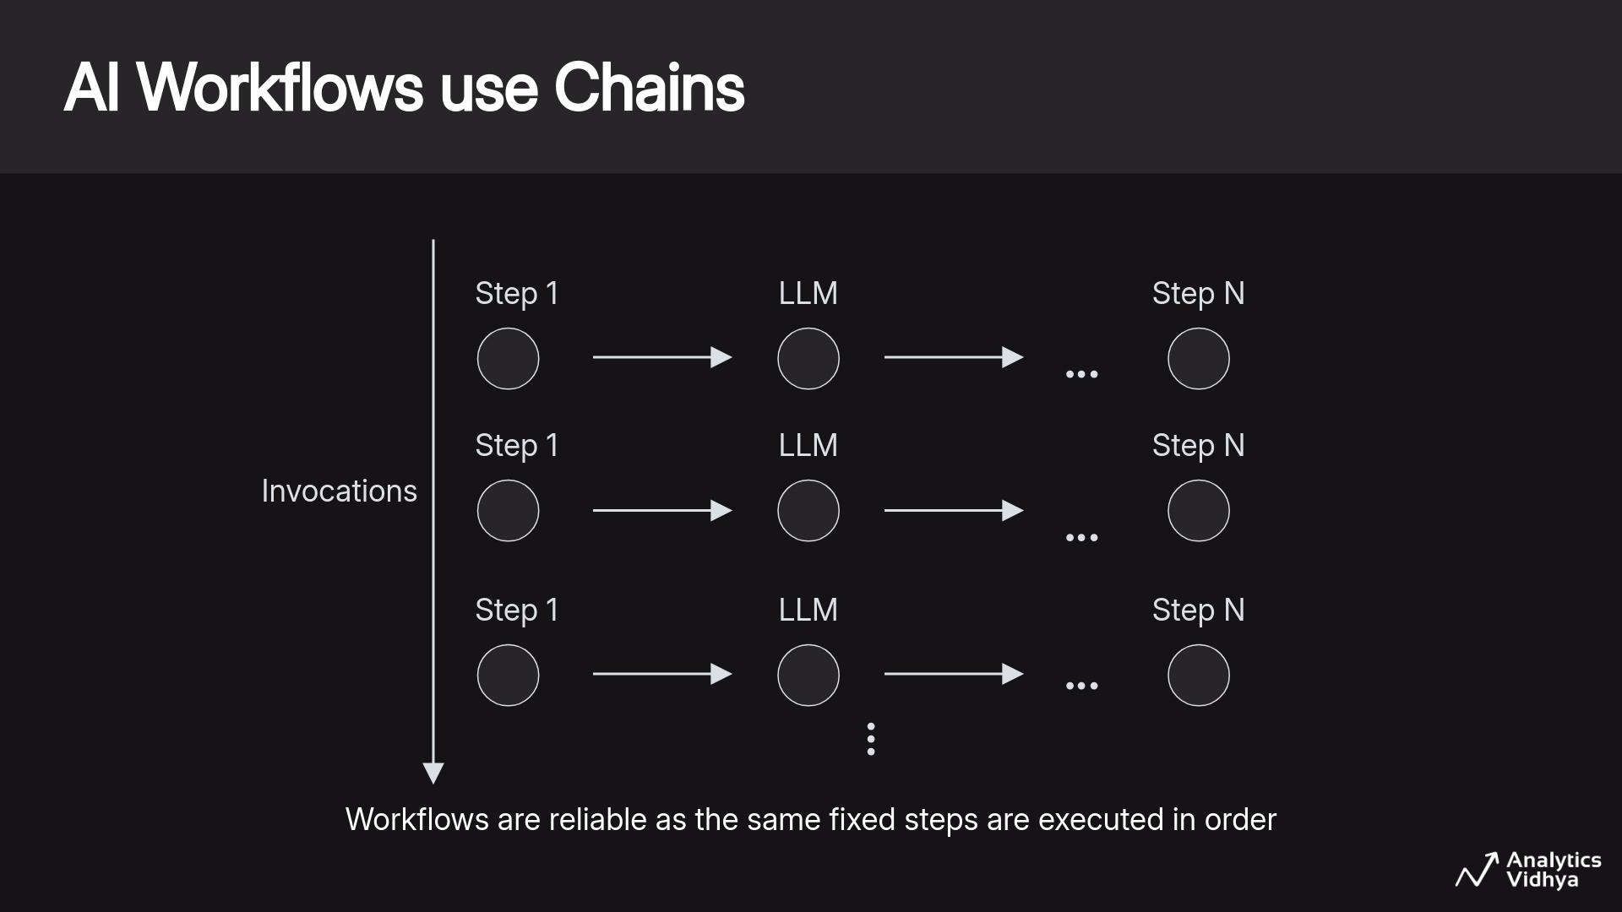

Slide 6
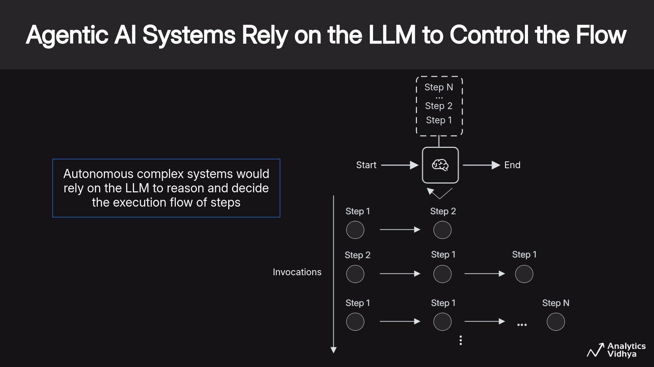

Slide 7
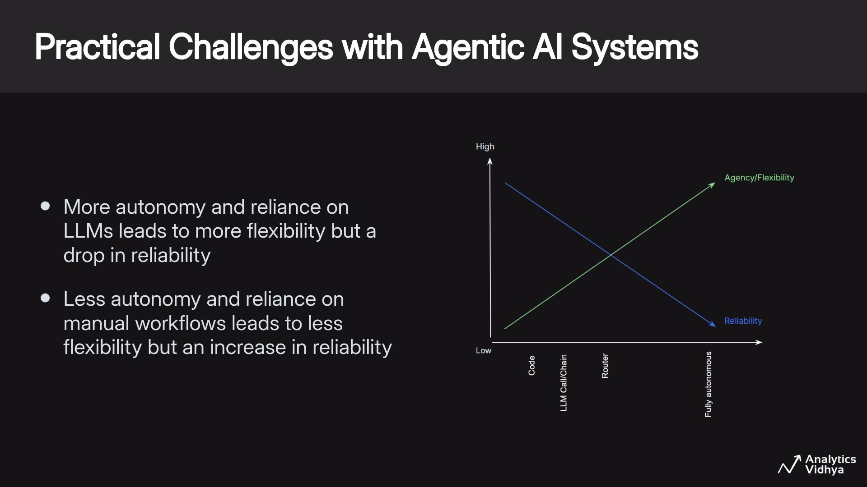

Slide 8
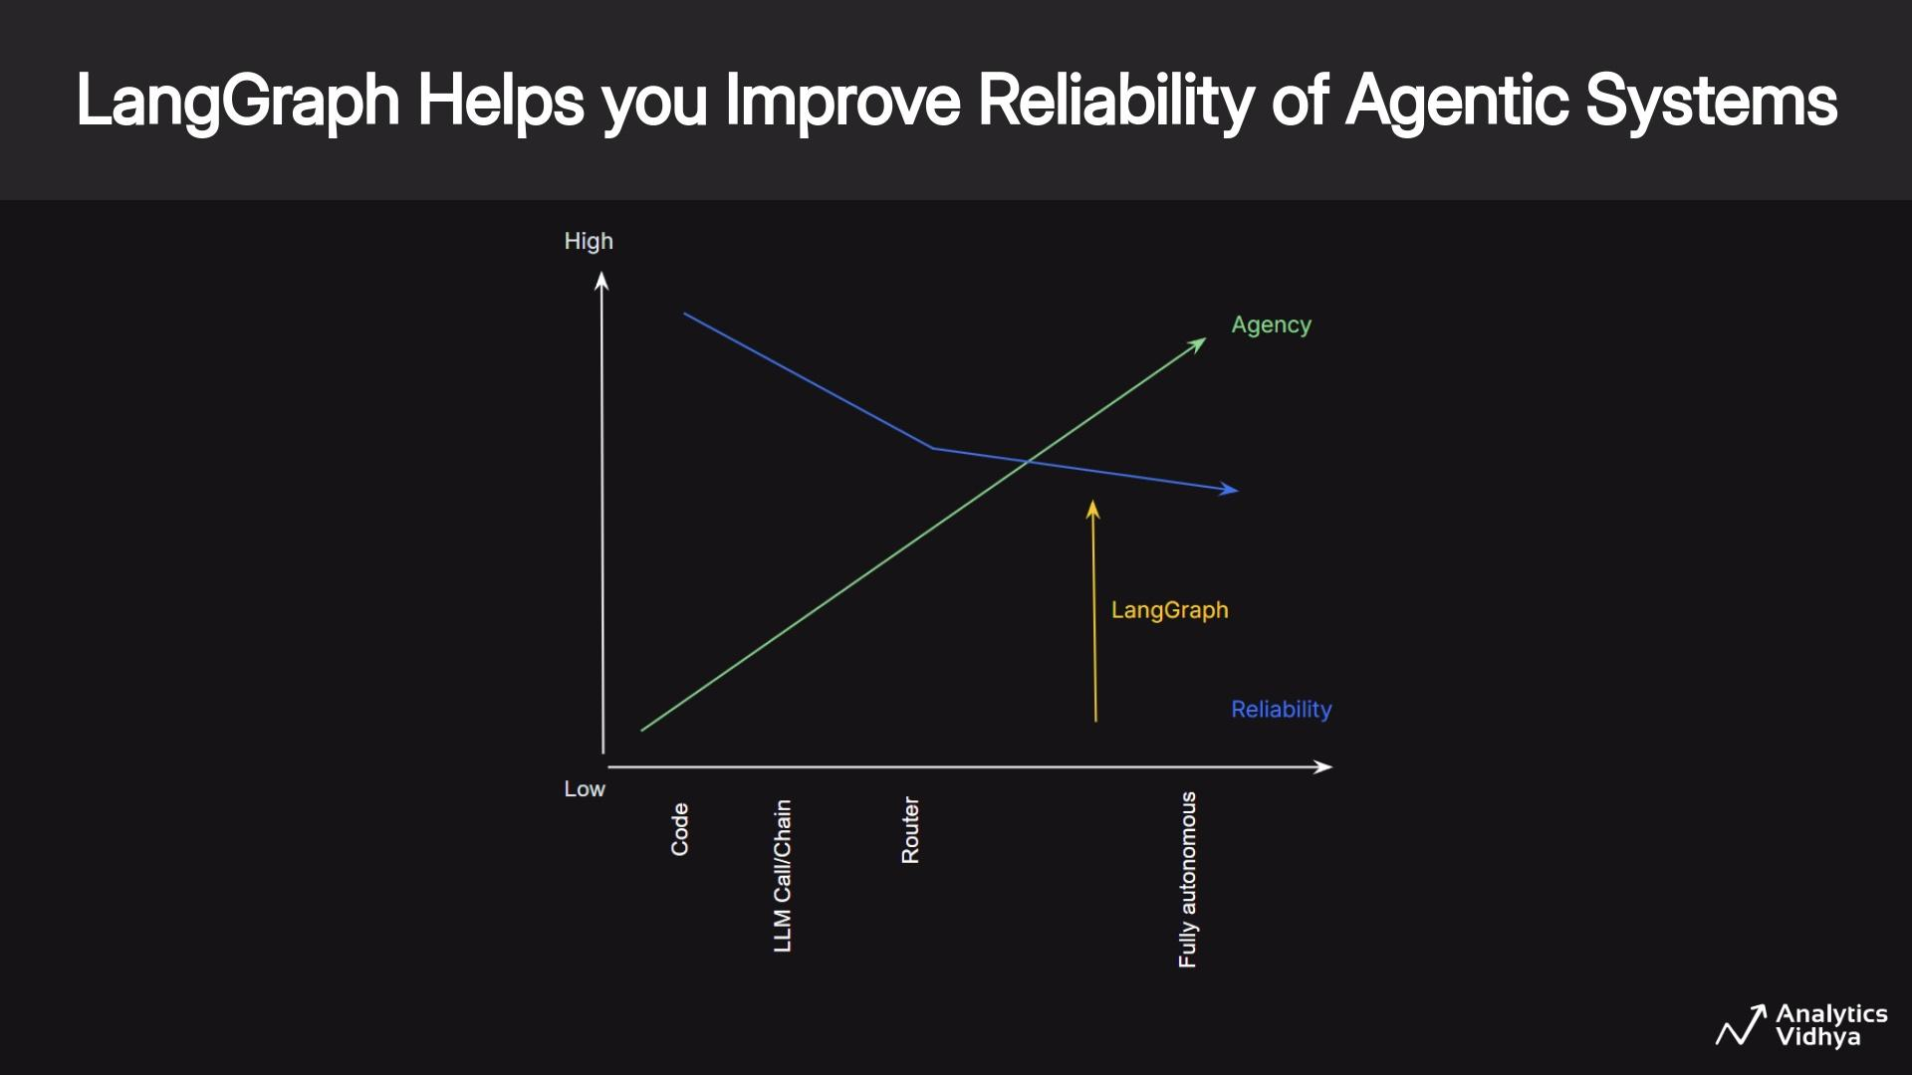

Slide 9
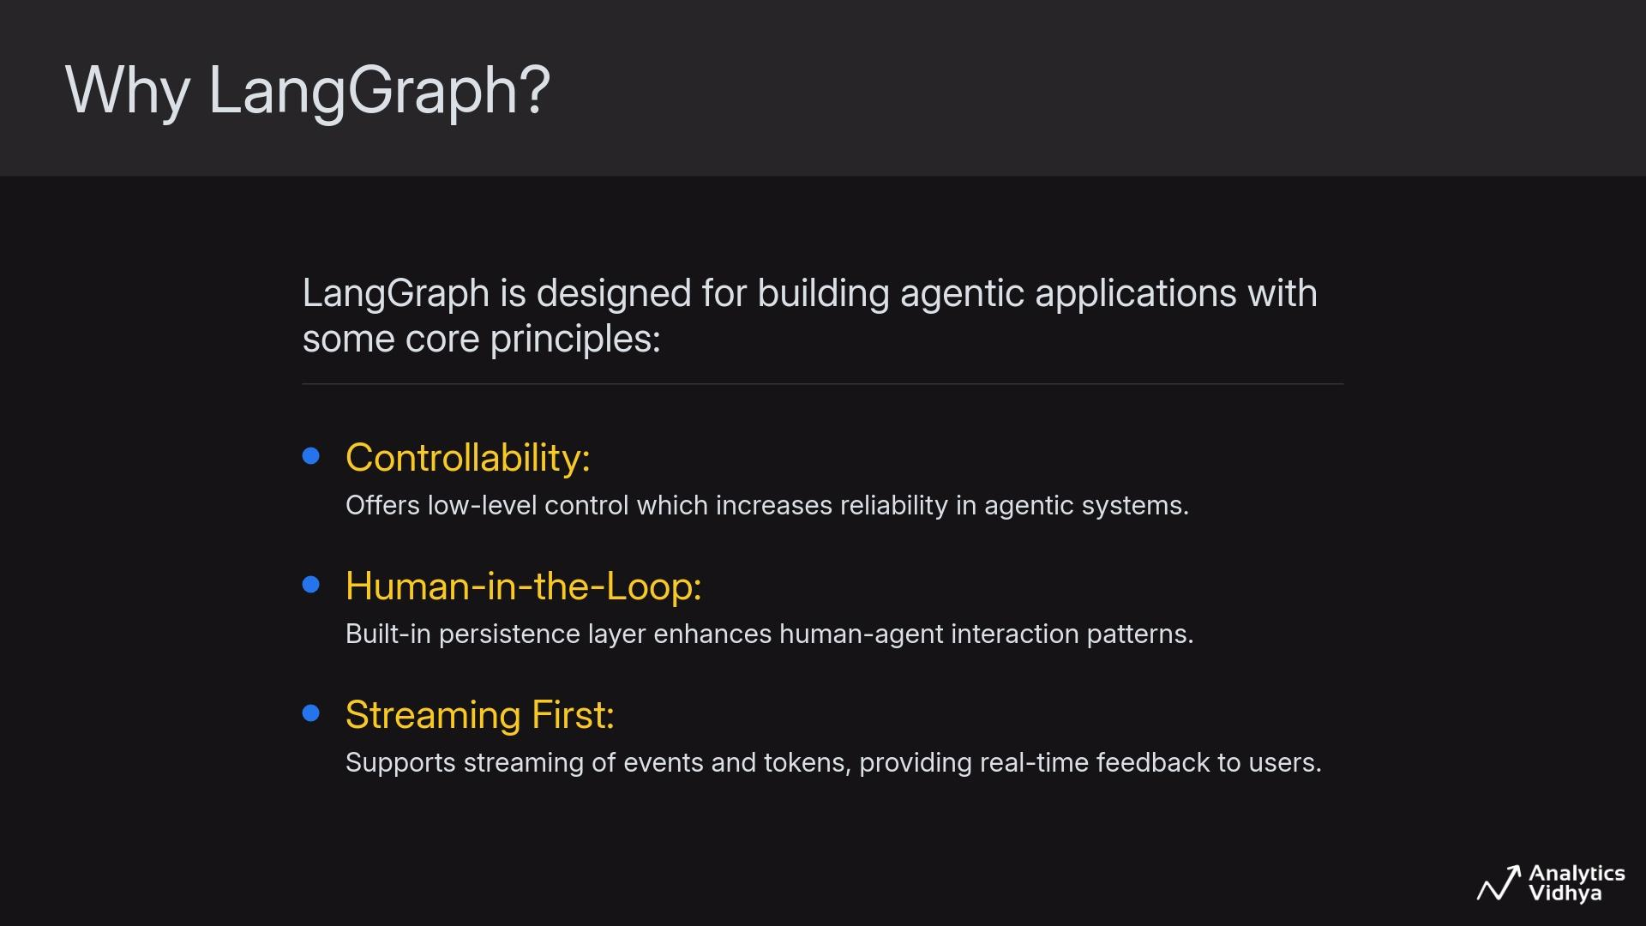

Slide 10
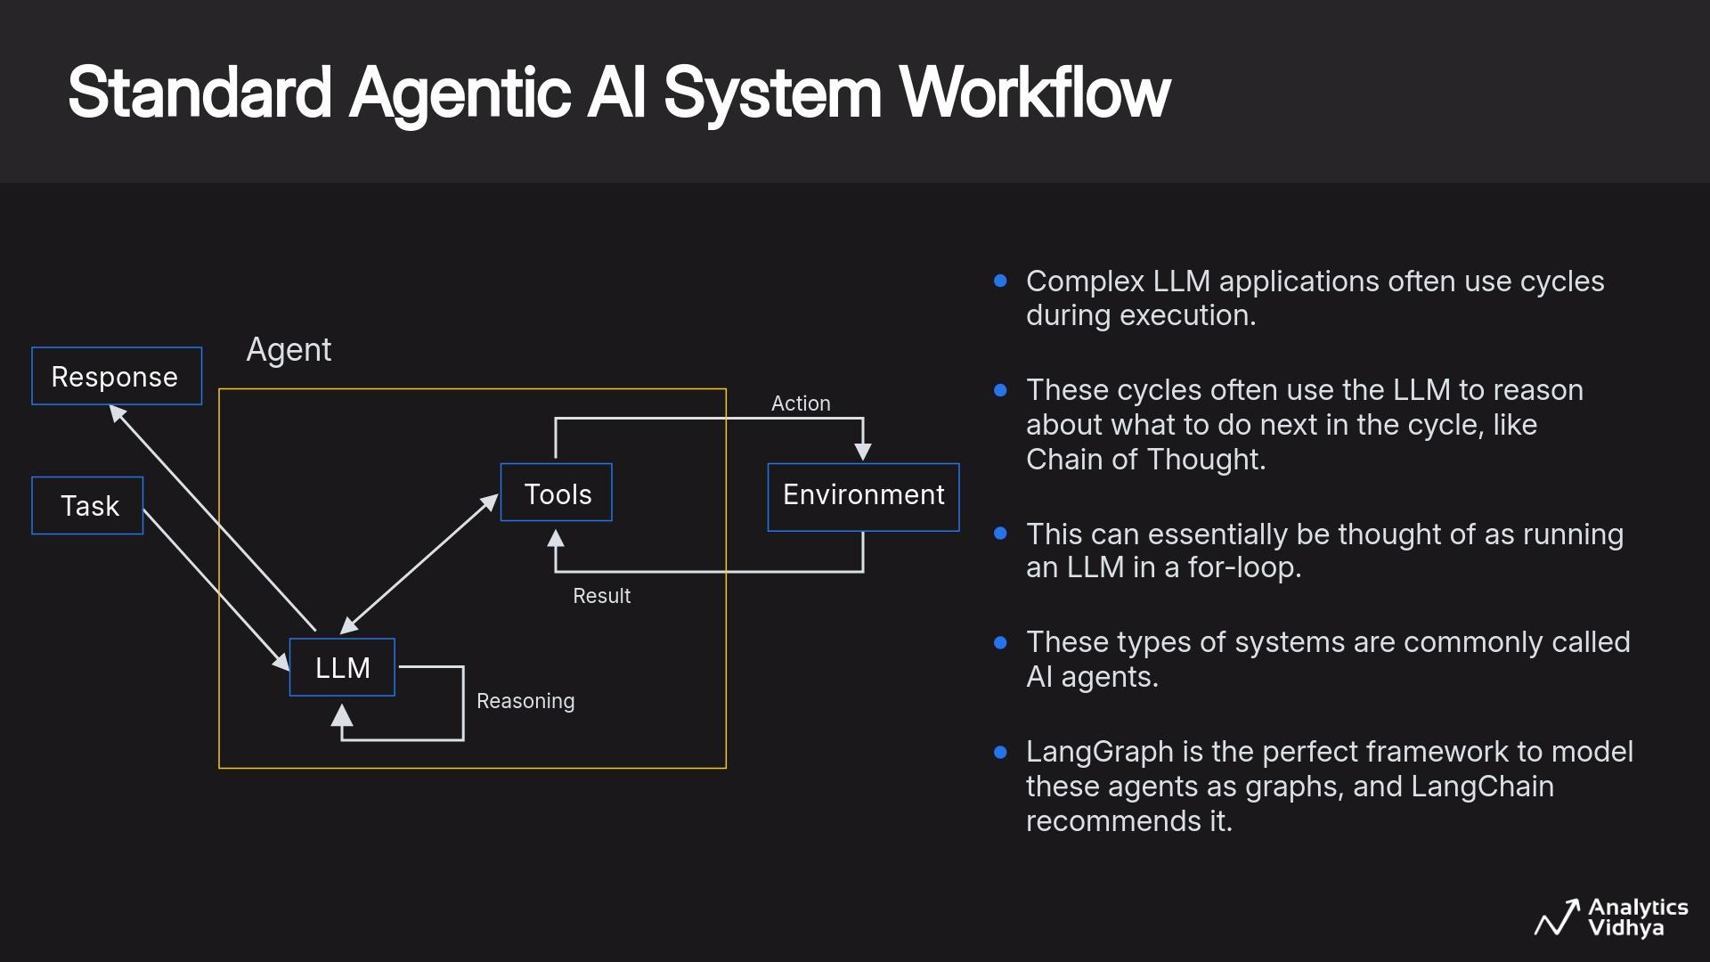

Slide 11
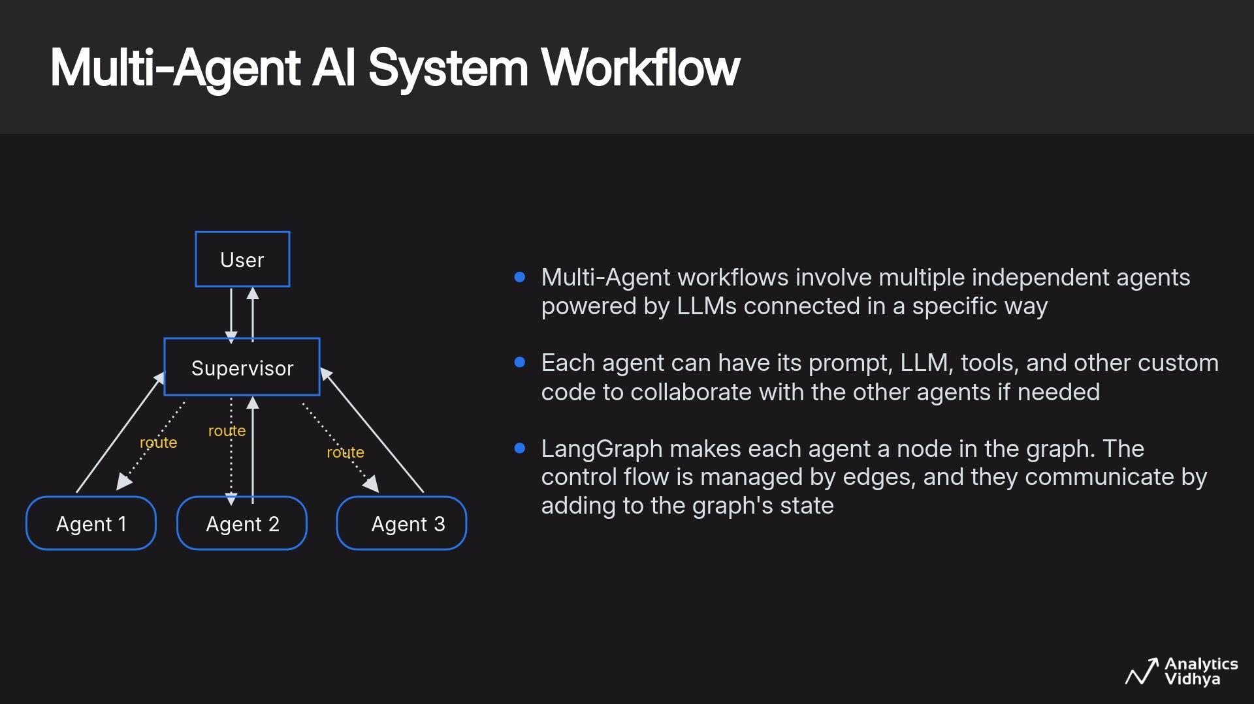

Slide 12
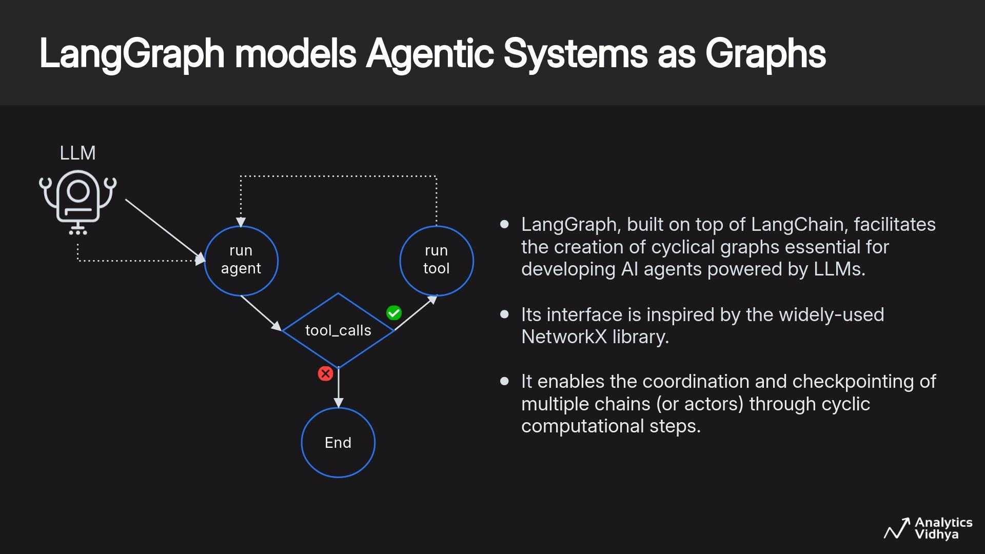

Slide 13
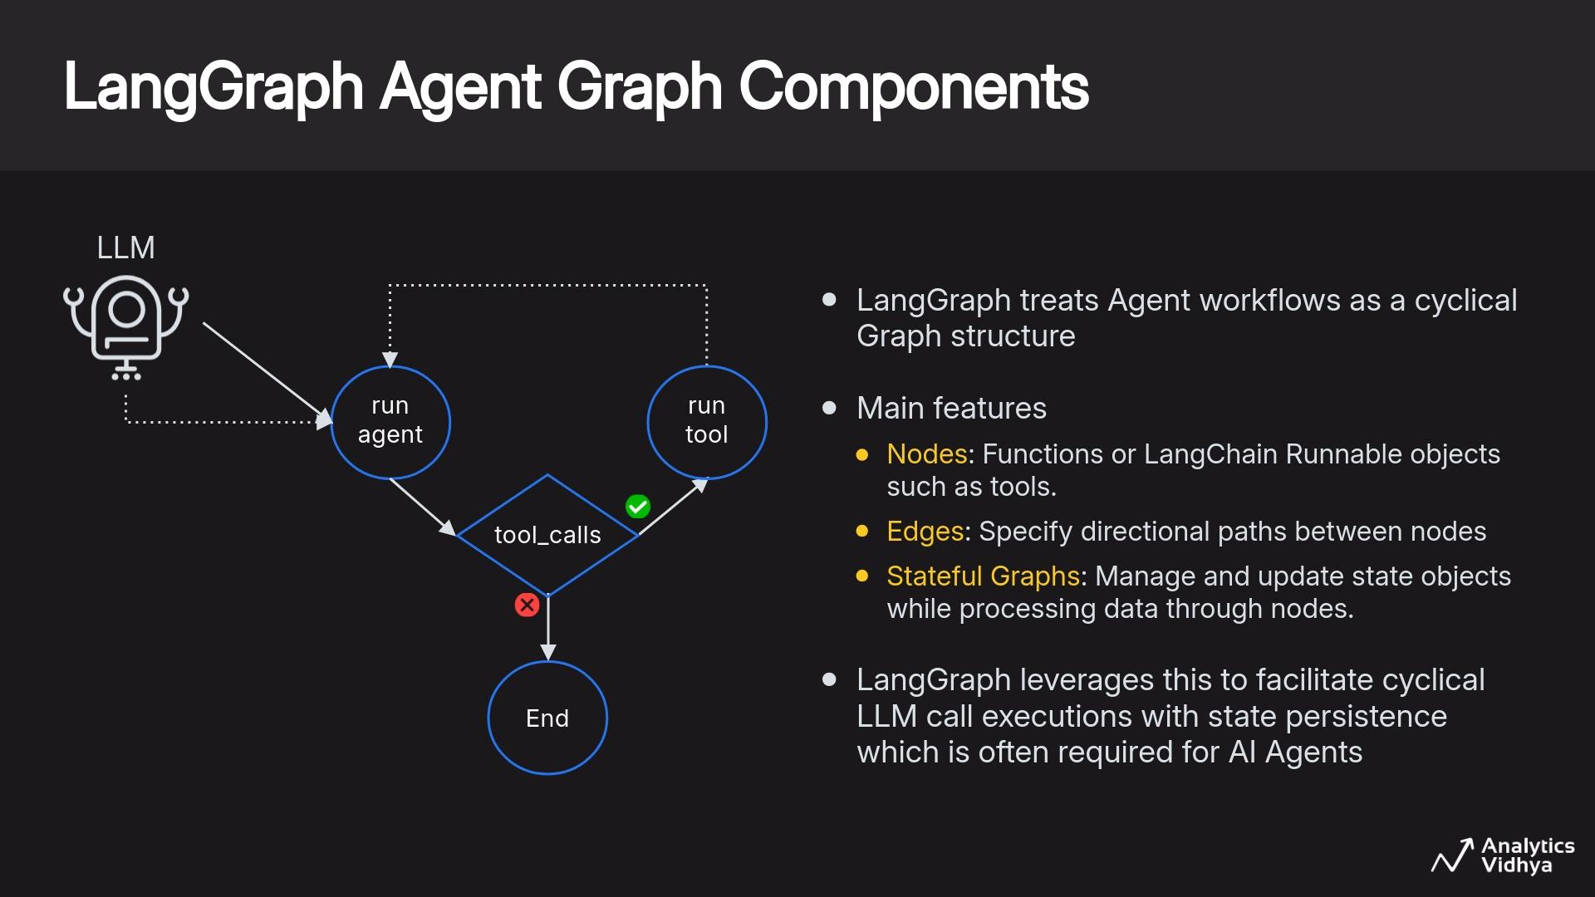

Slide 14
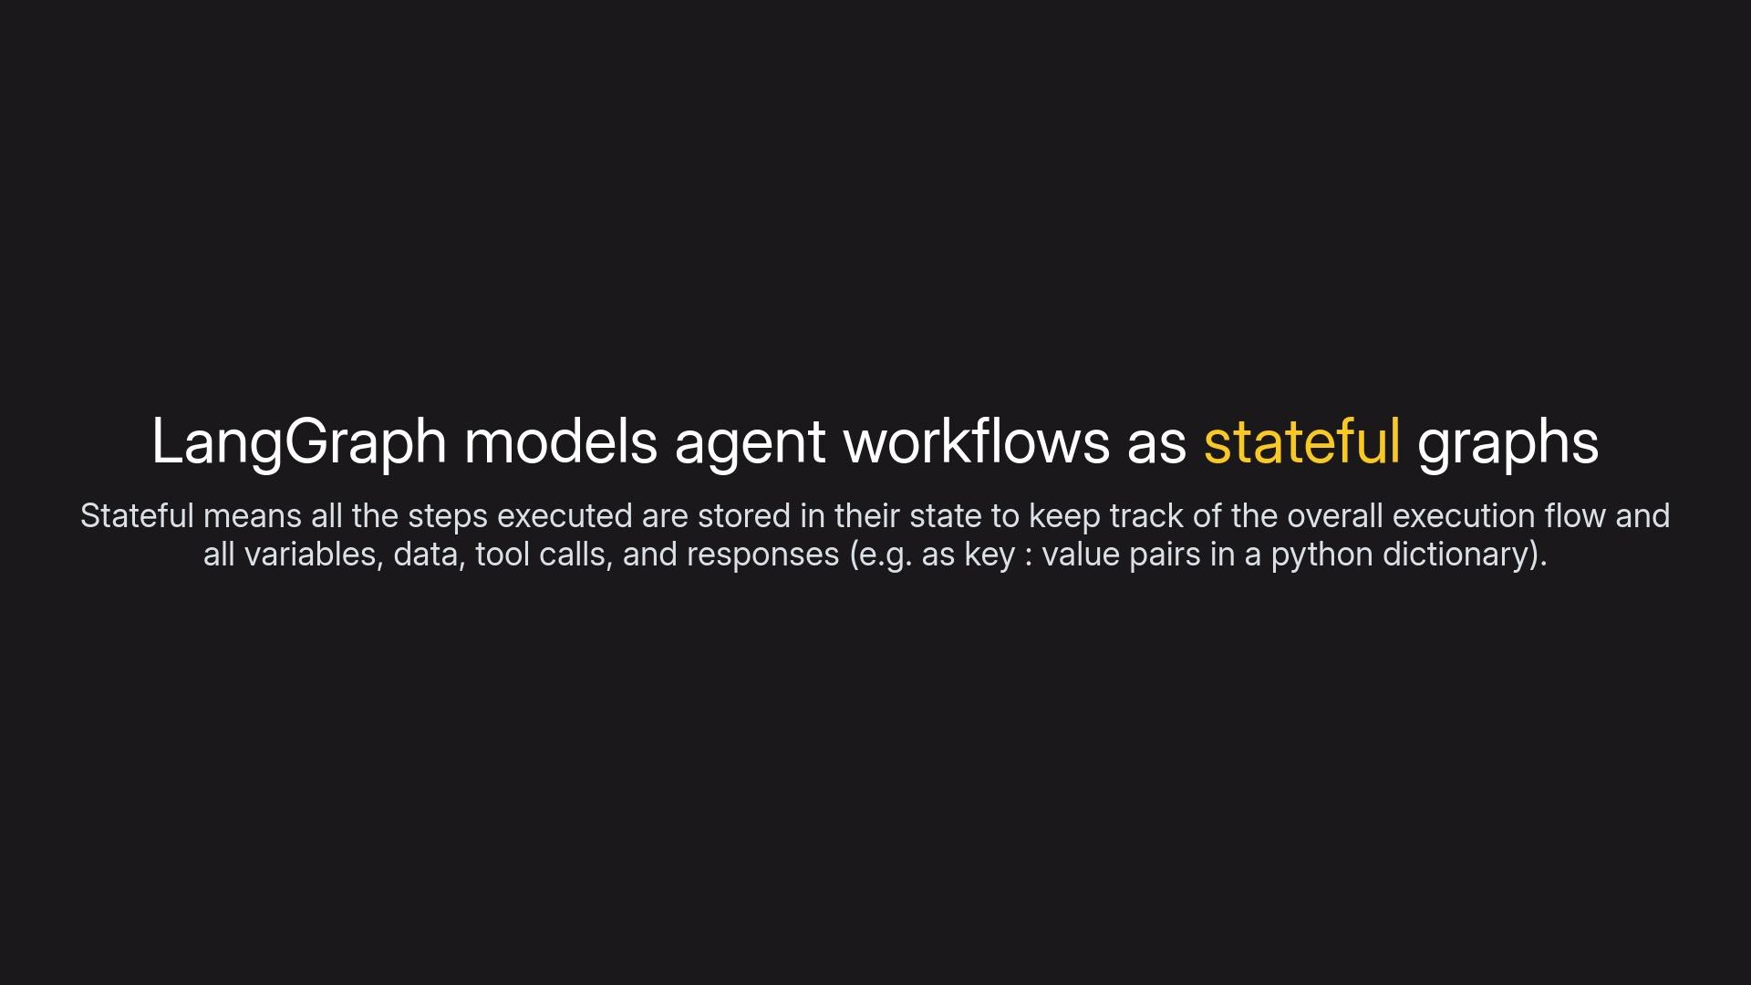

Slide 15
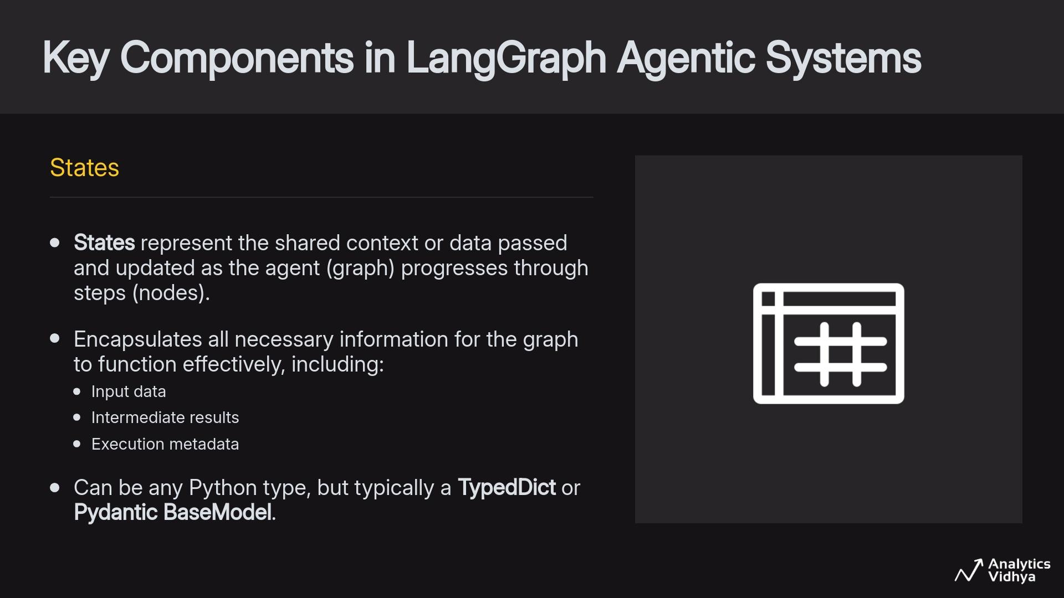

Slide 16
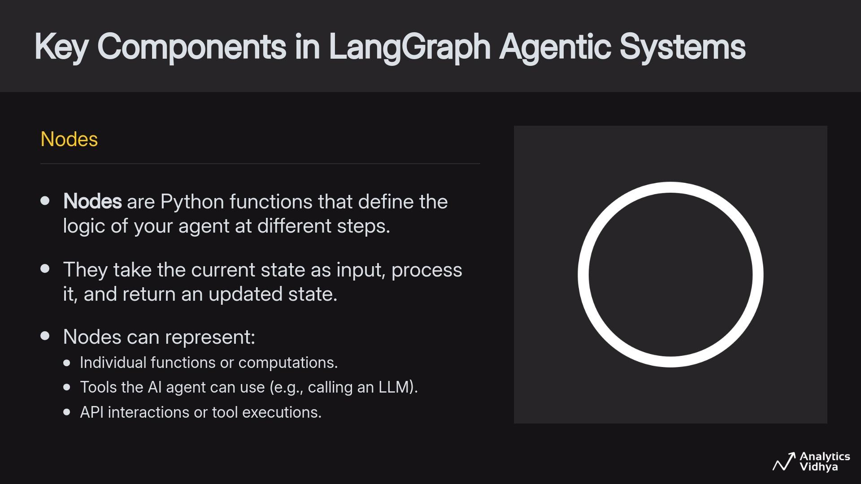

Slide 17
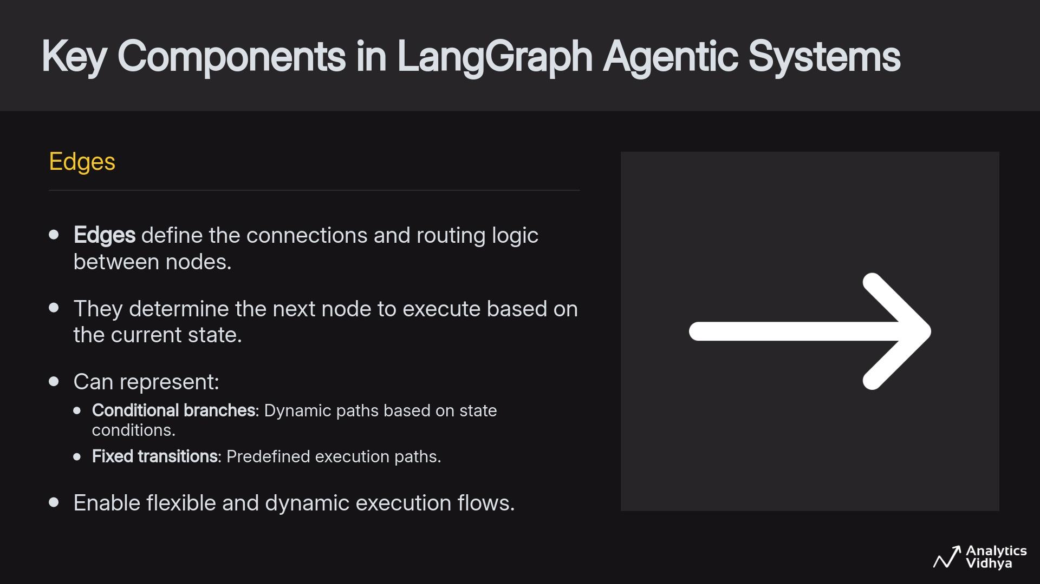

Slide 18
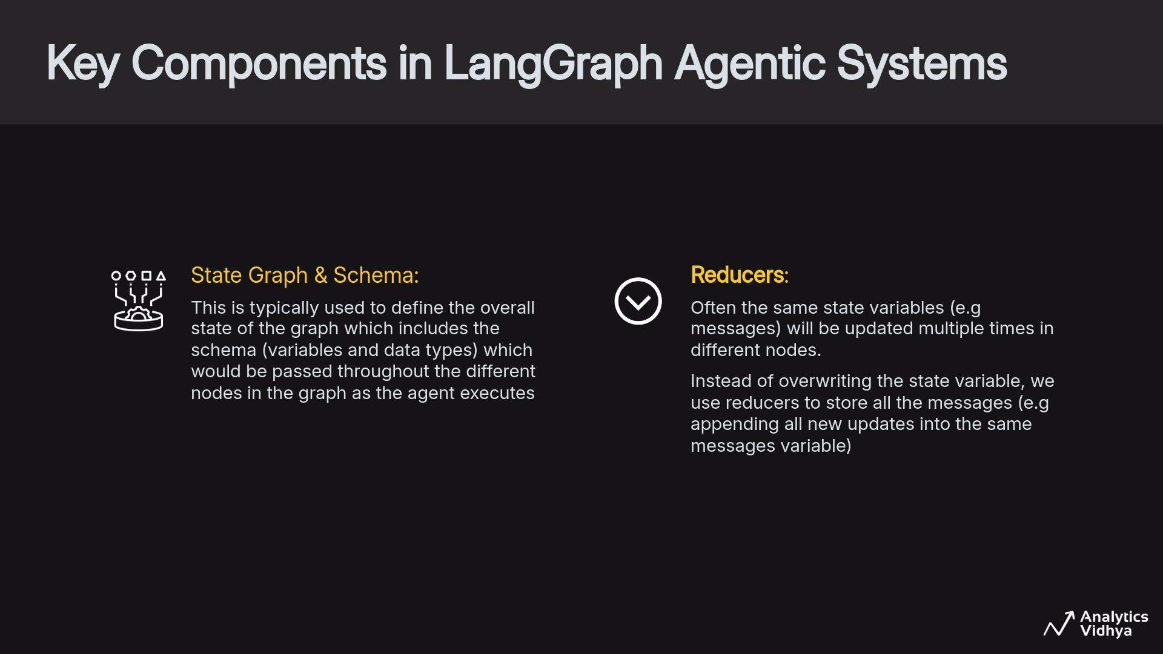

Slide 19
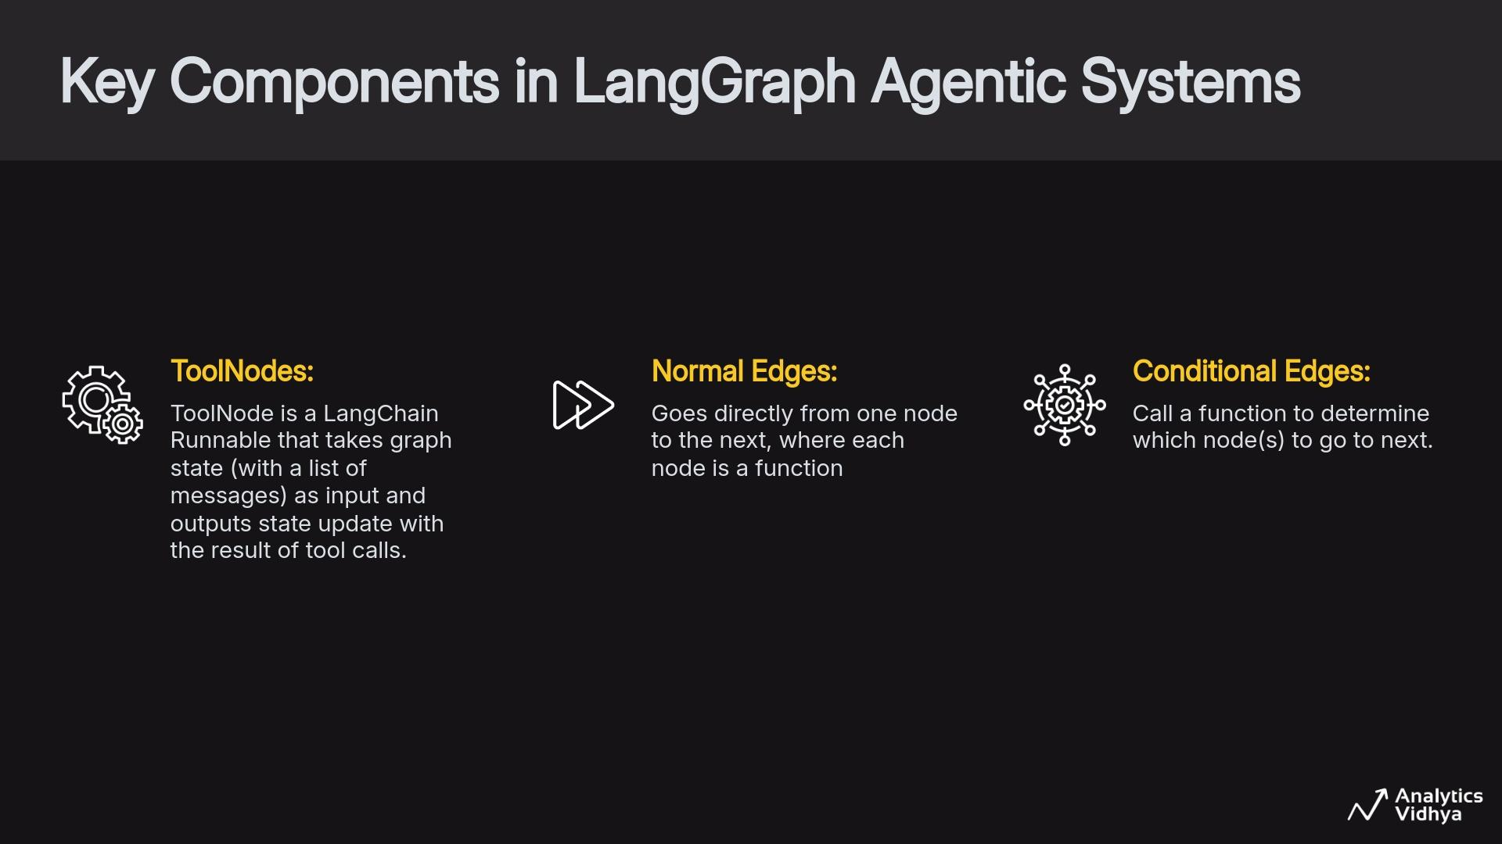

Slide 20

Live Coding - Session 1
Simple Agentic Graph and State Management in LangGraph
Get the notebook from HERE
Run it on Colab by copying to your drive or local system & follow along with the instructor
Recommended to run on Google Colab

Slide 21
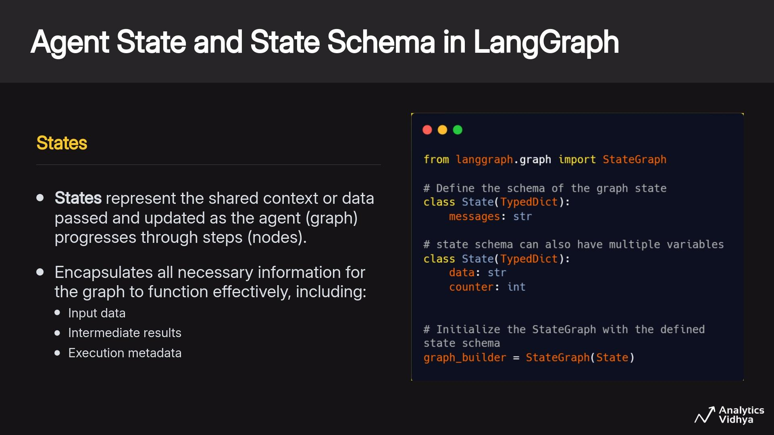

Slide 22
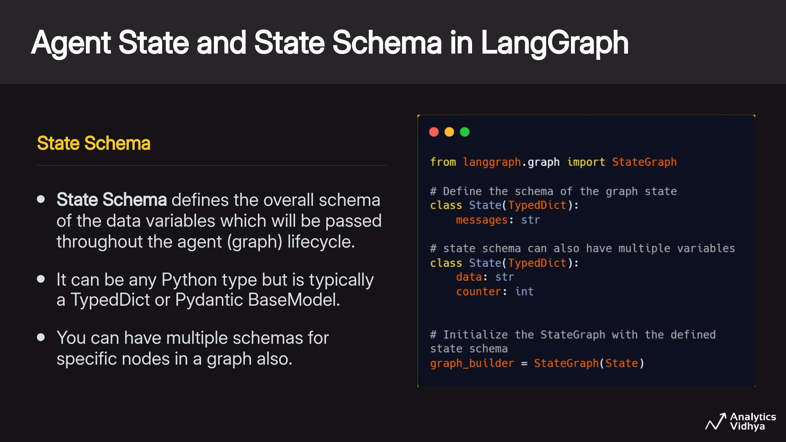

Slide 23
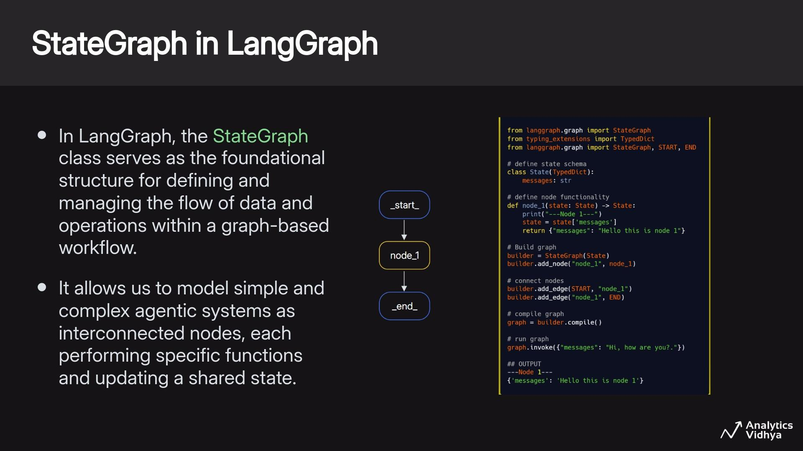

Slide 24
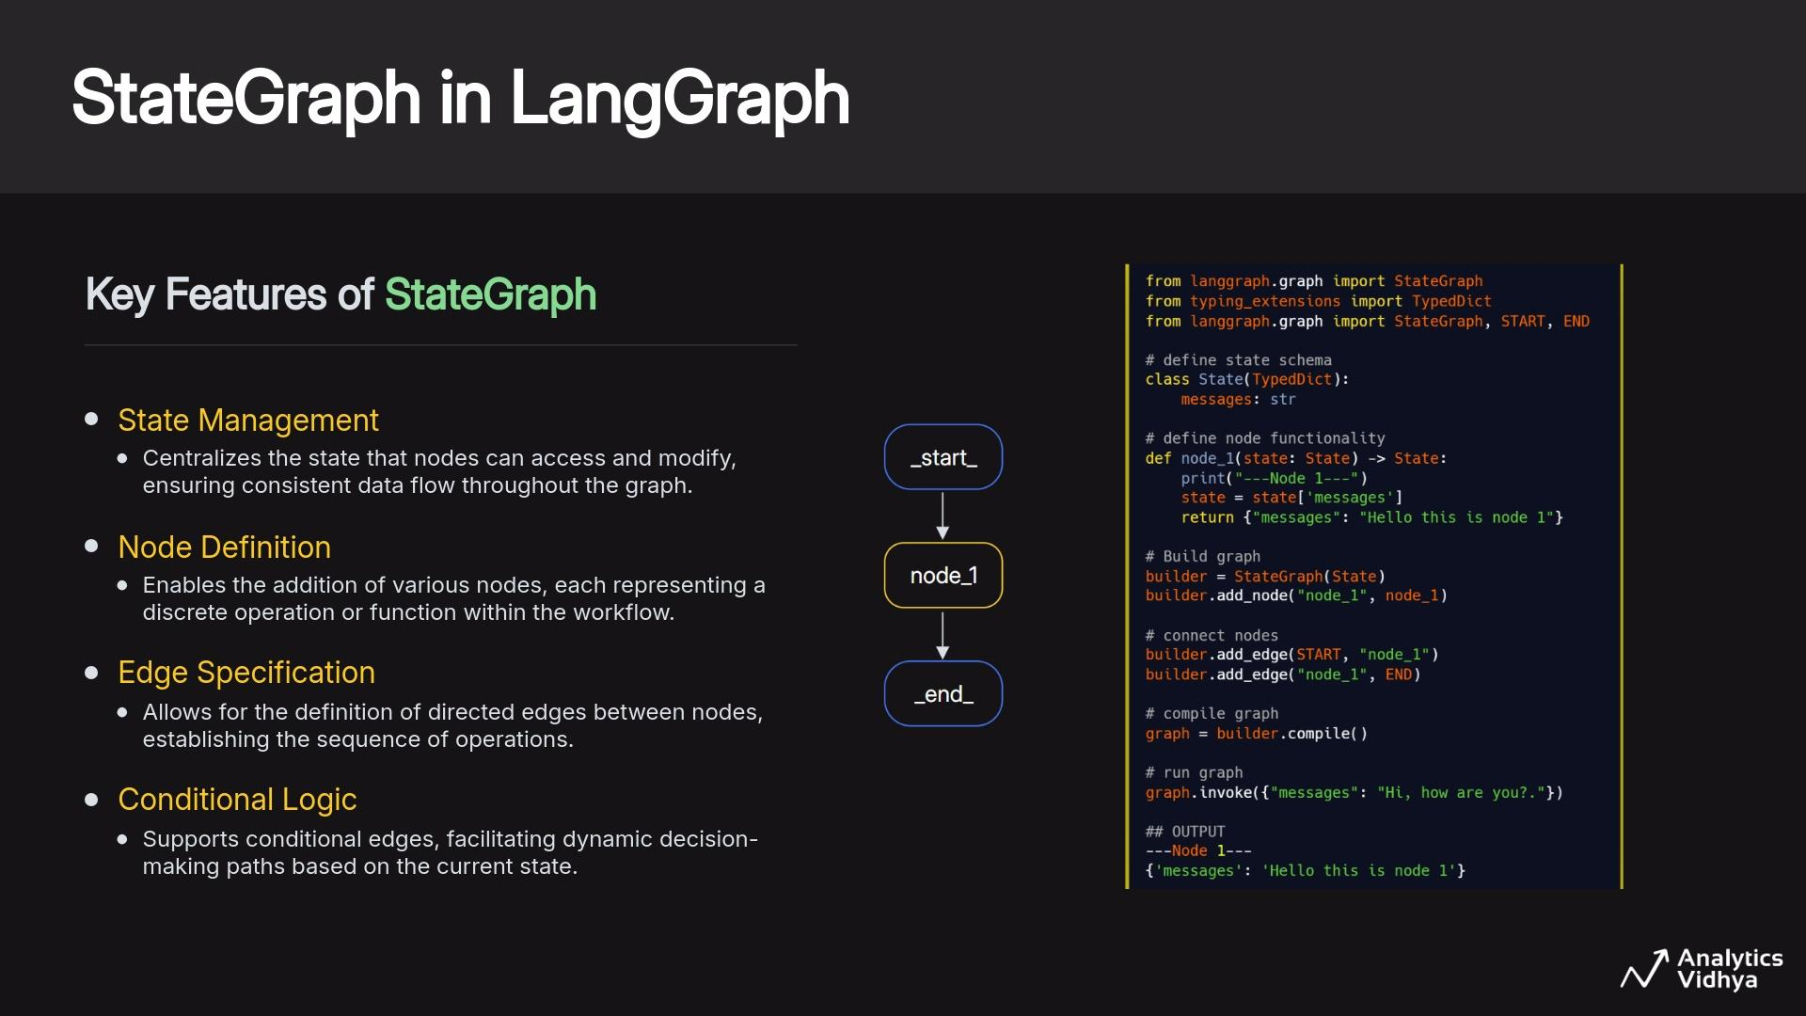

Slide 25
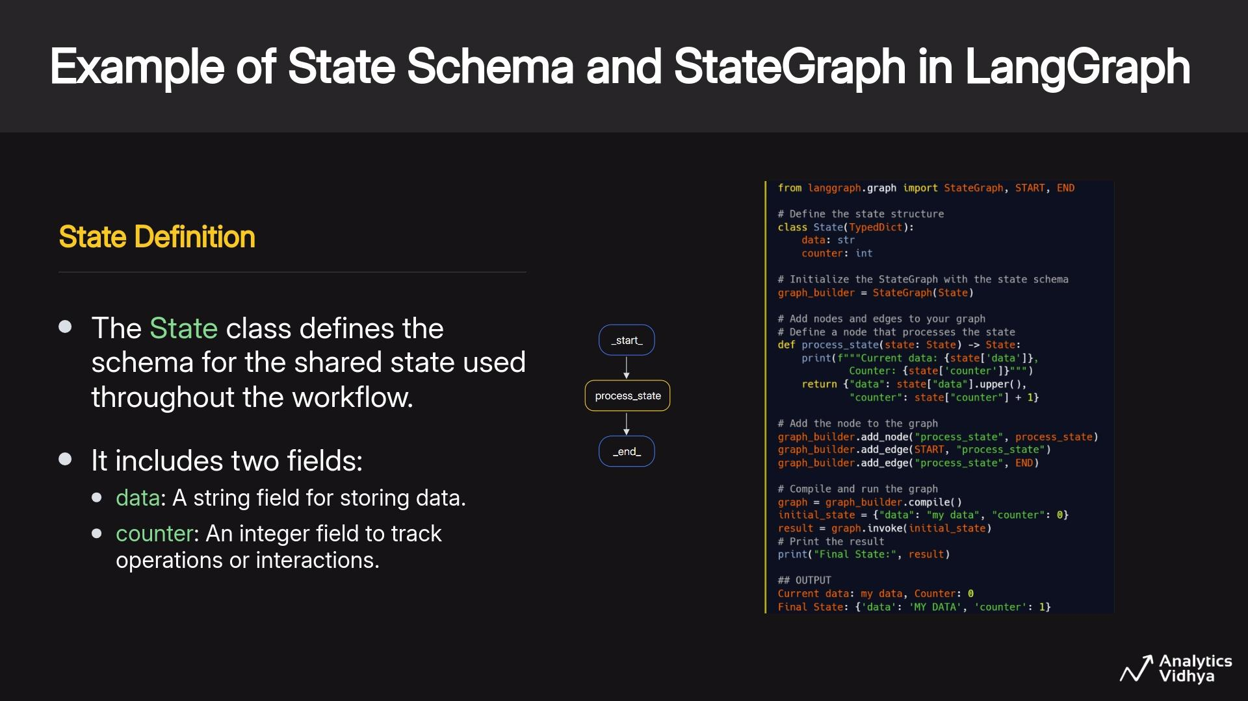

Slide 26
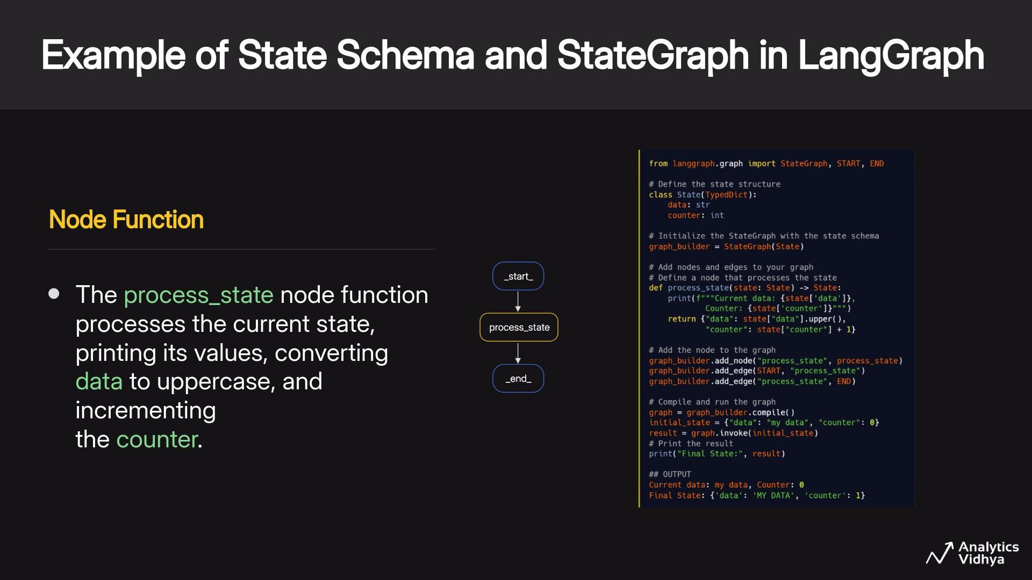

Slide 27
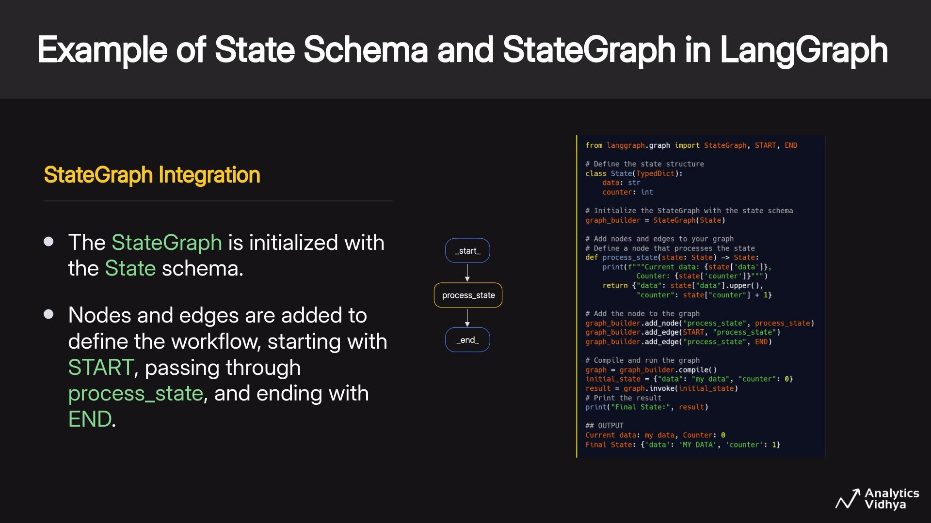

Slide 28
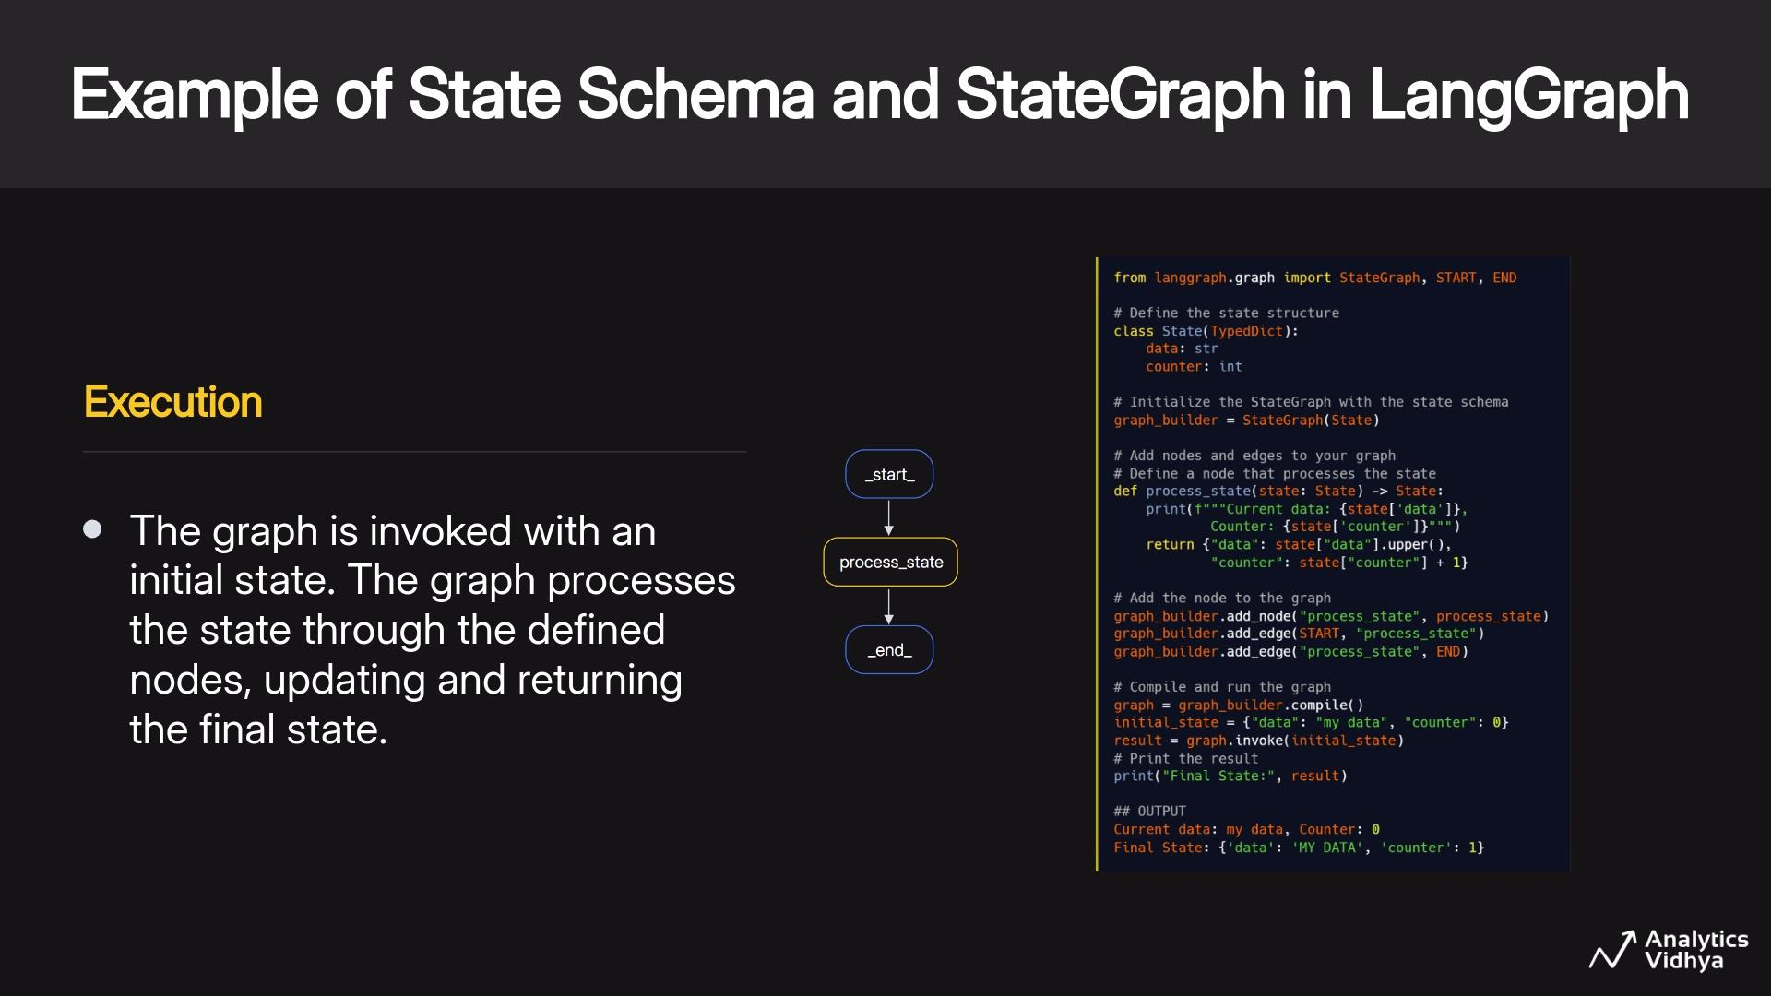

Slide 29
Live Coding - Session 1
Simple Agentic Graph and State Management in LangGraph
Get the notebook from HERE
Run it on Colab by copying to your drive or local system & follow along with the instructor
Recommended to run on Google Colab

Slide 30
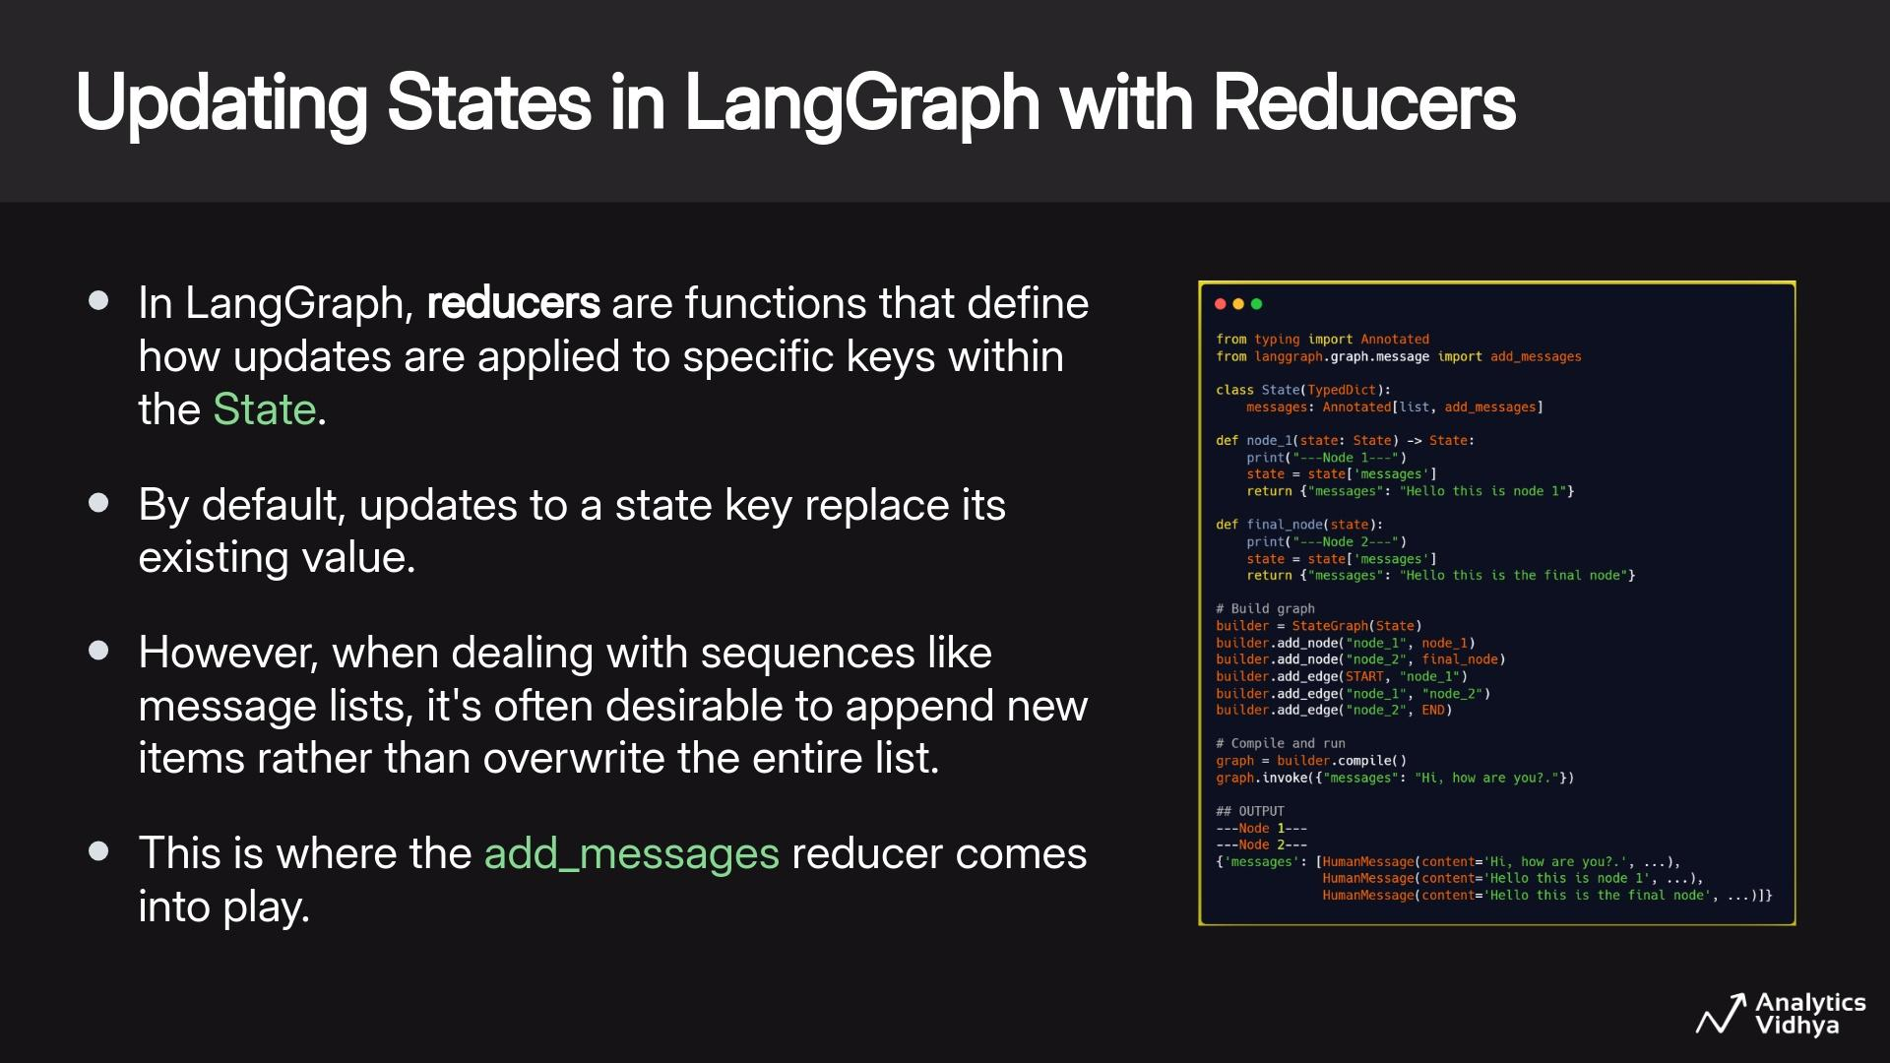

Slide 31
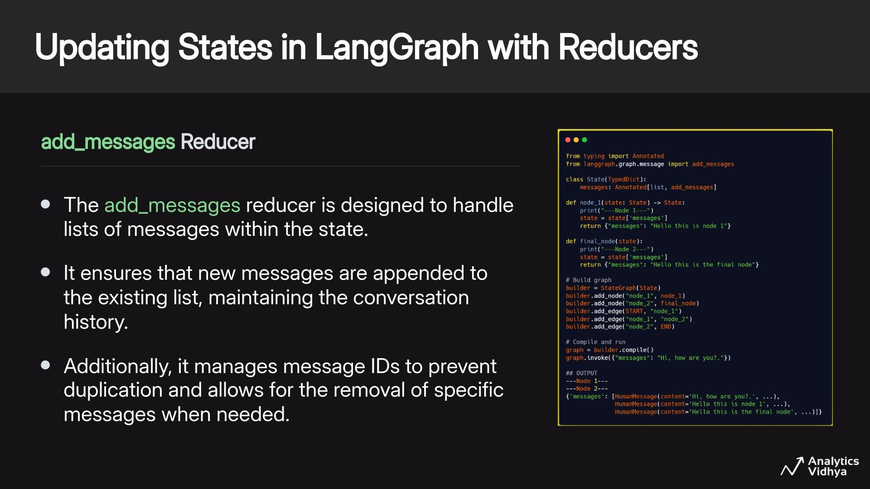

Slide 32
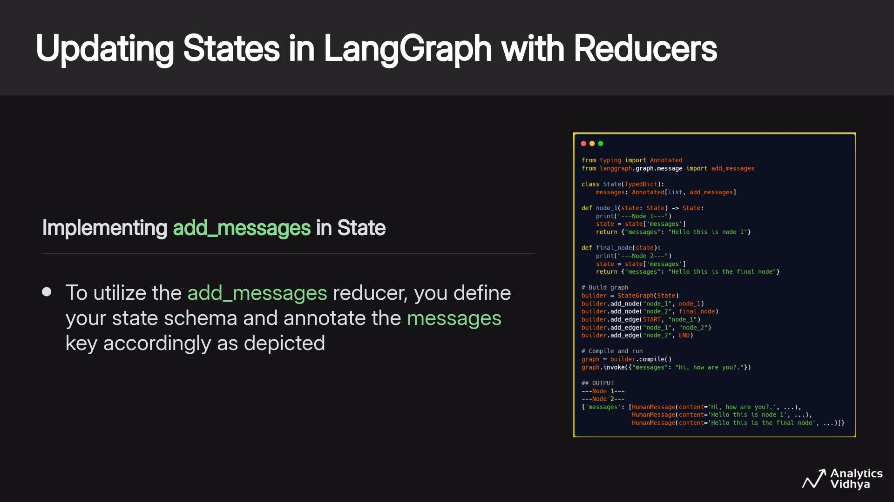

Slide 33
Live Coding - Session 1
Simple Agentic Graph and State Management in LangGraph
Get the notebook from HERE
Run it on Colab by copying to your drive or local system & follow along with the instructor
Recommended to run on Google Colab

Slide 34
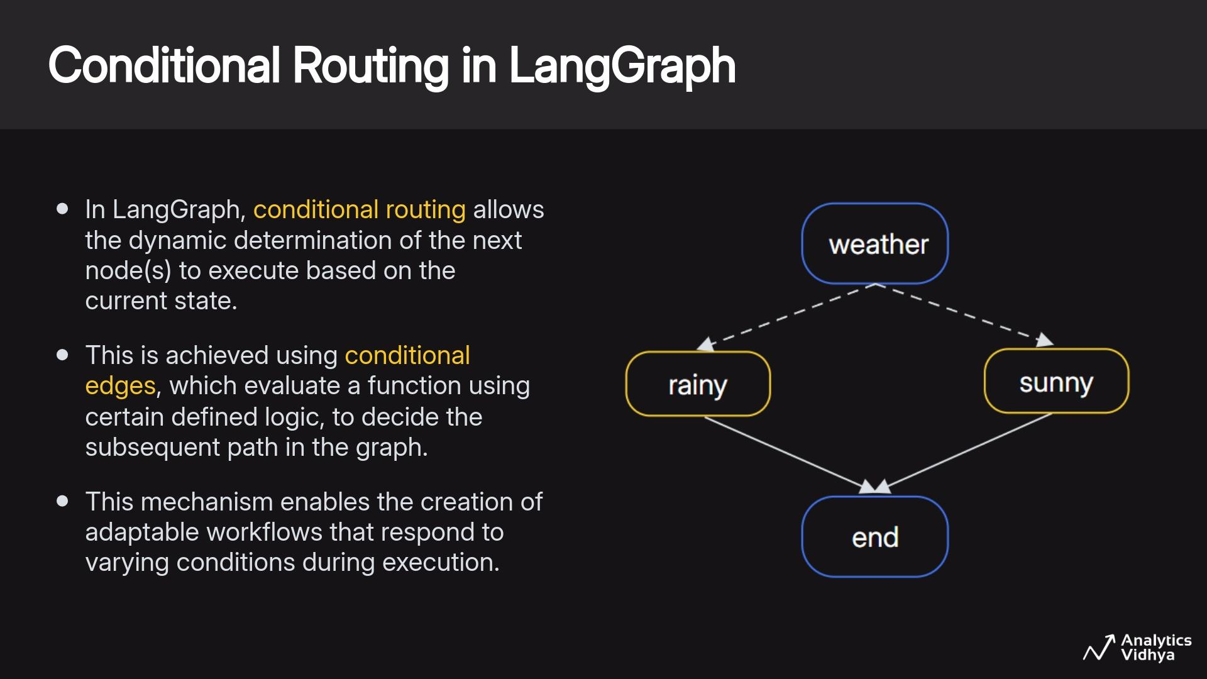

Slide 35
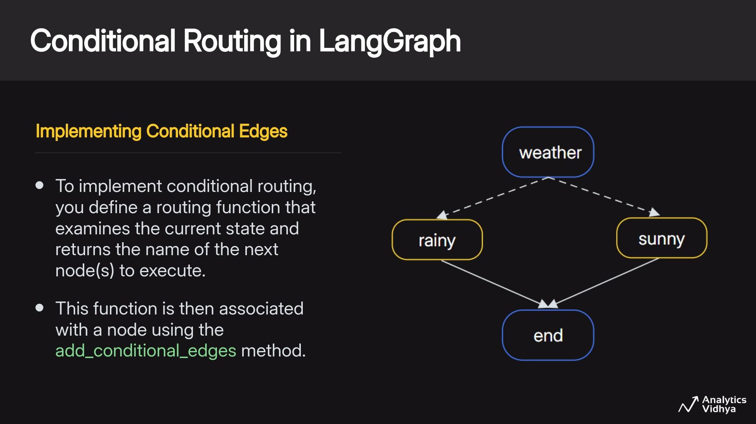

Slide 36
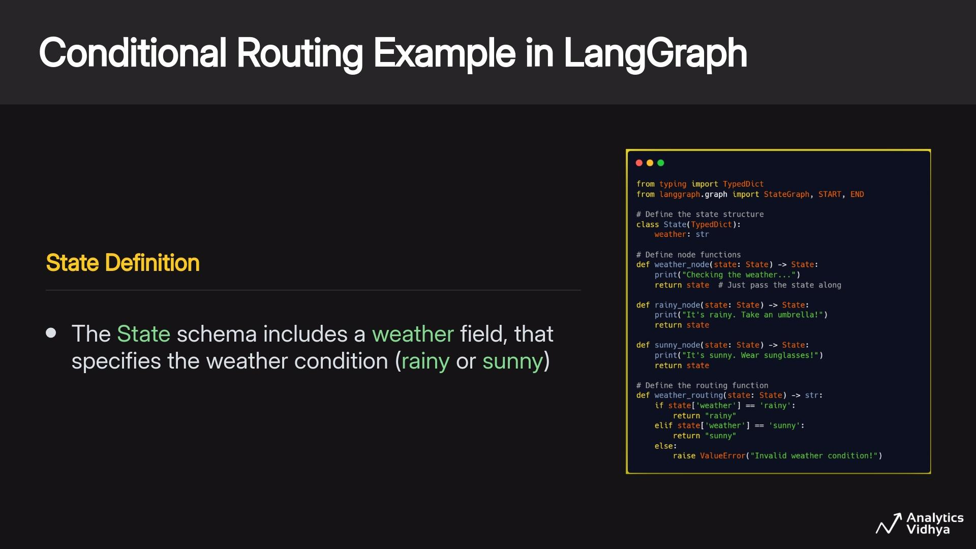

Slide 37
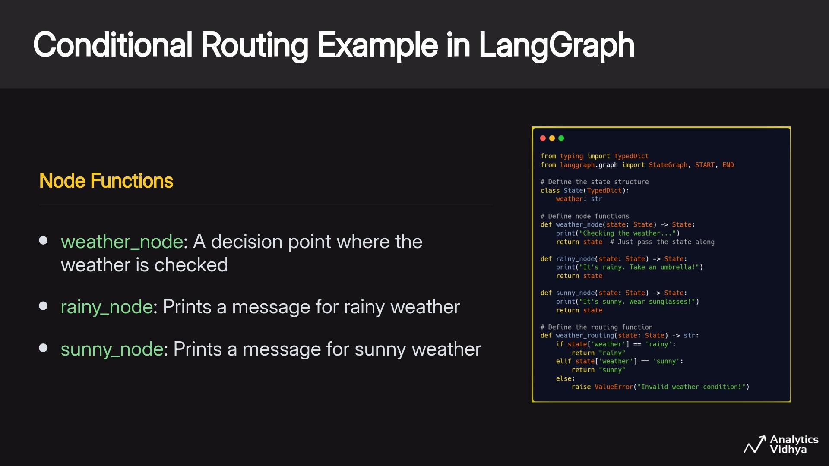

Slide 38
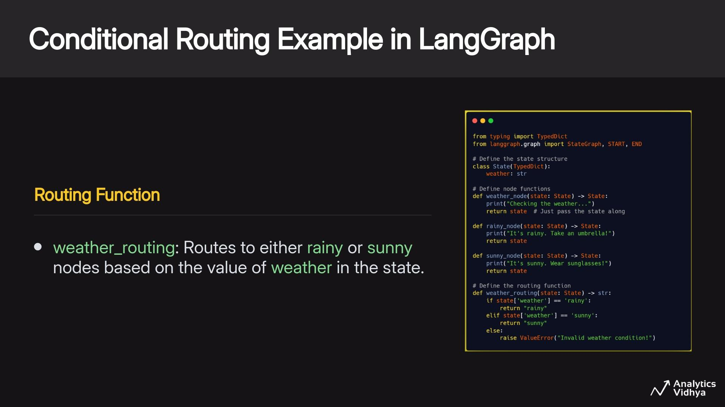

Slide 39
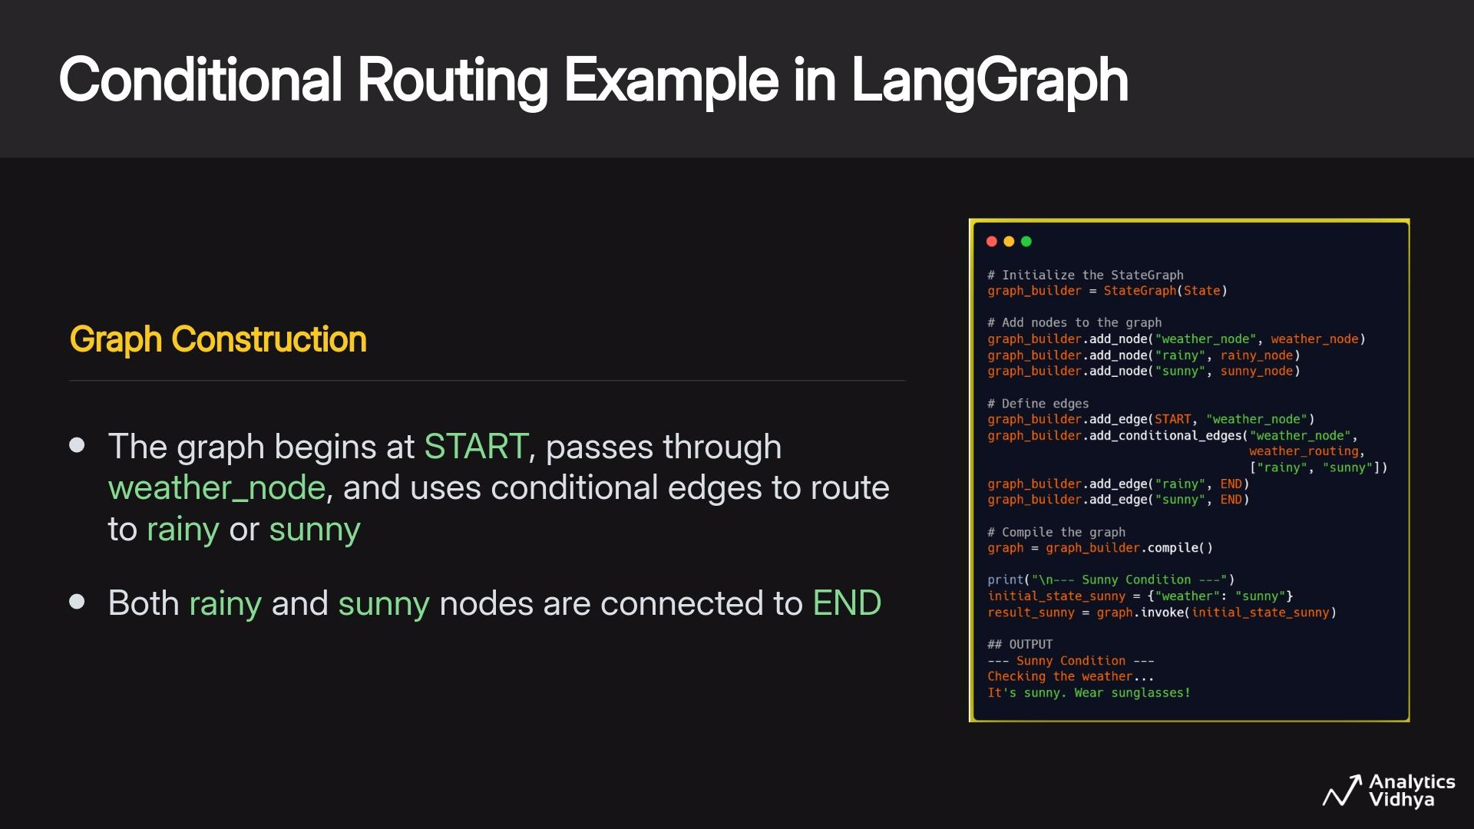

Slide 40
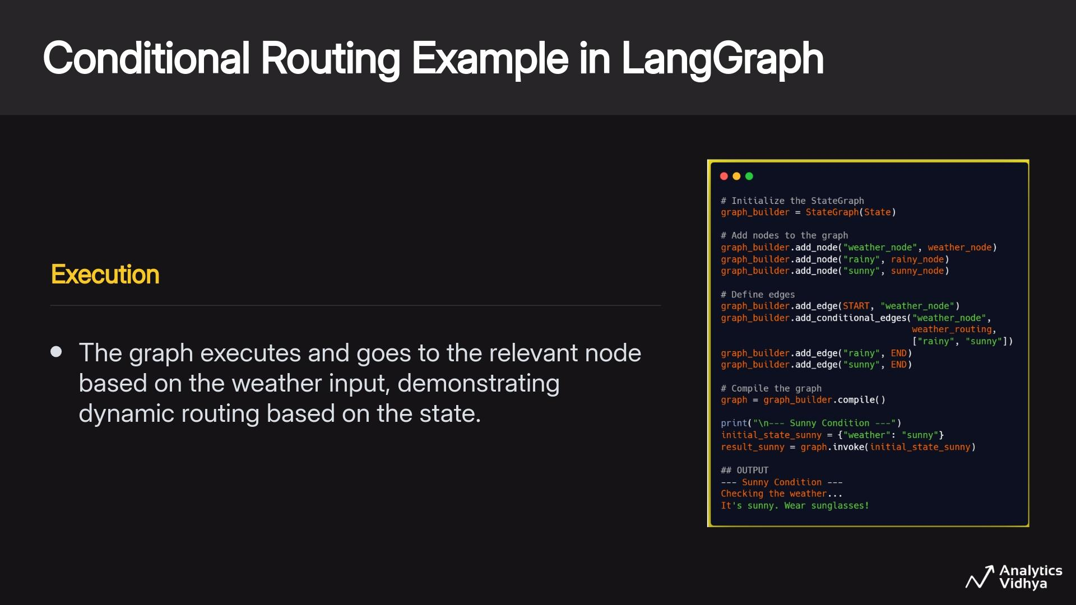

Slide 41
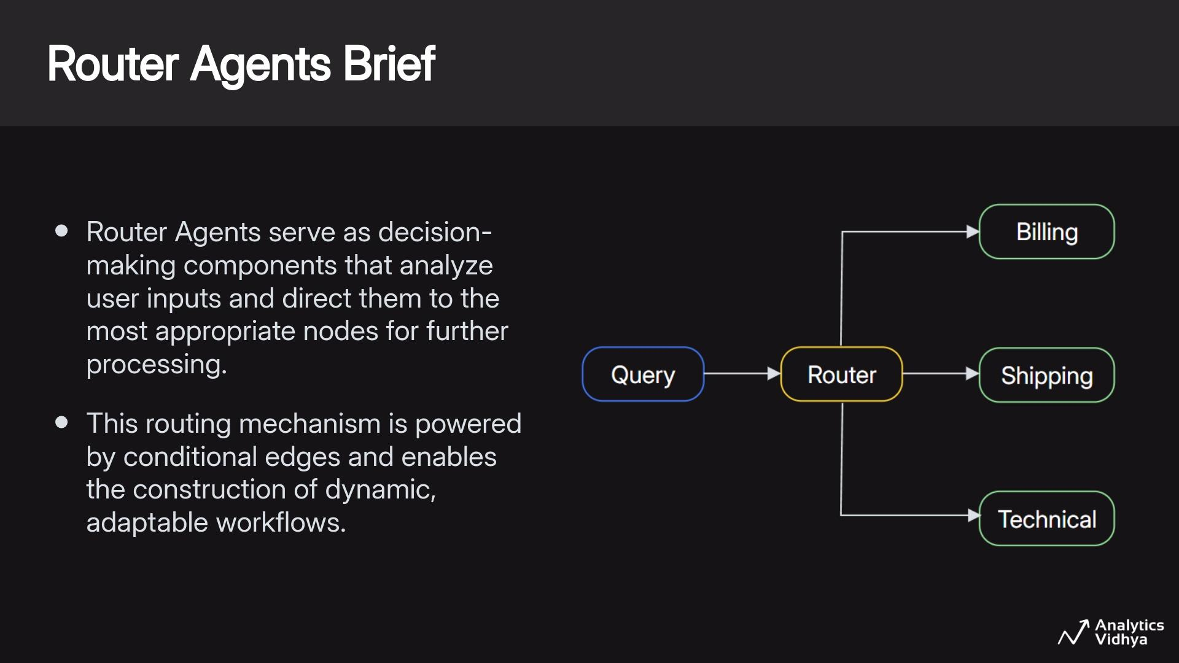

Slide 42
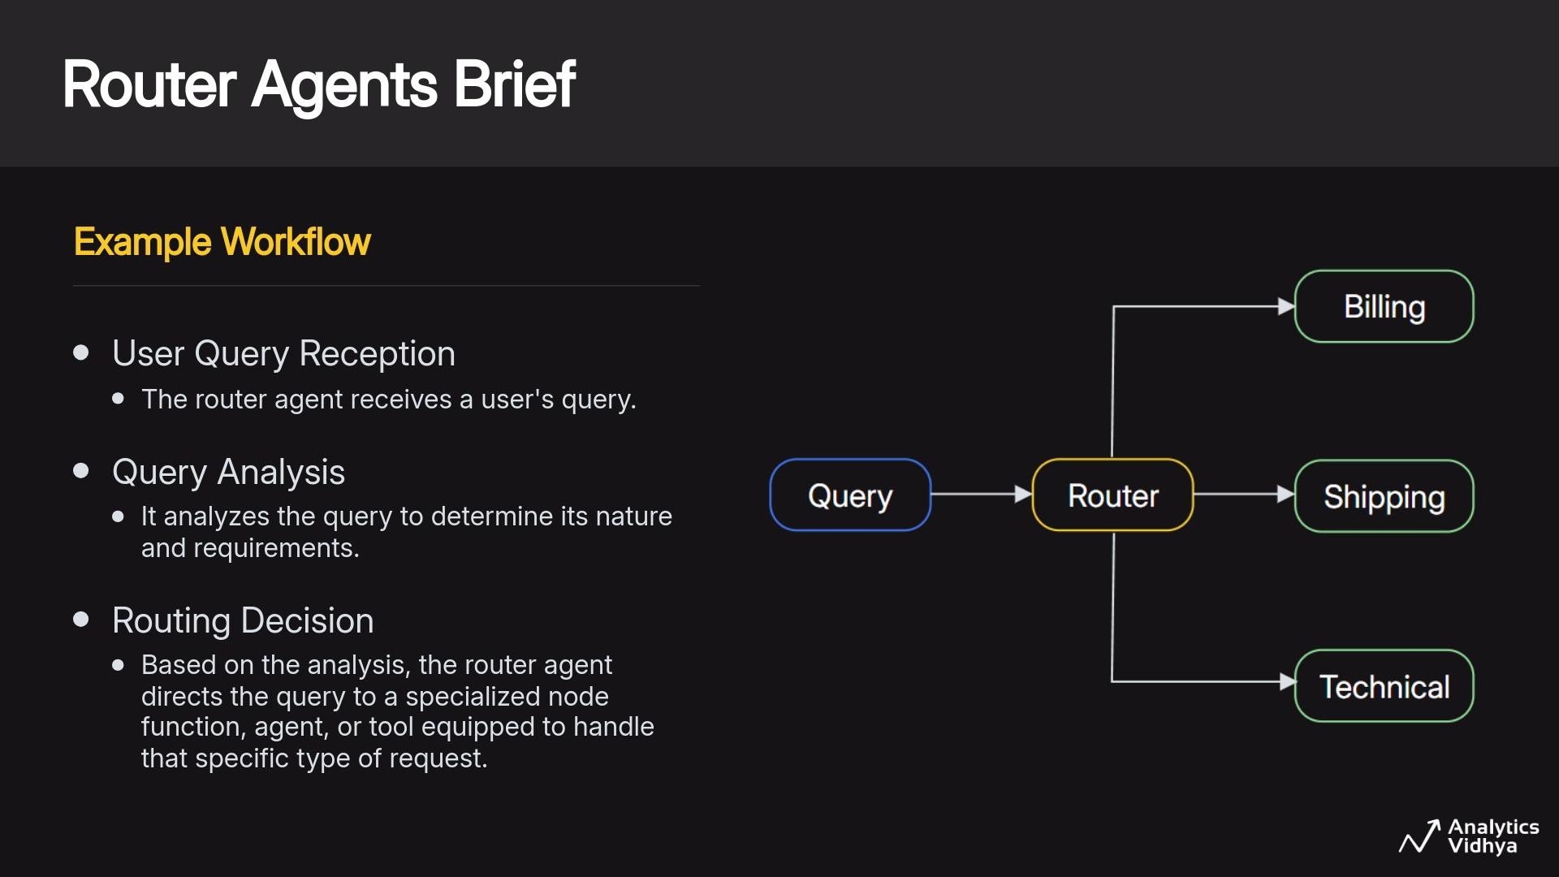

Slide 43
Live Coding - Session 2
Conditional Routing in LangGraph
Get the notebook from HERE
Run it on Colab by copying to your drive or local system & follow along with the instructor
Recommended to run on Google Colab

Slide 44
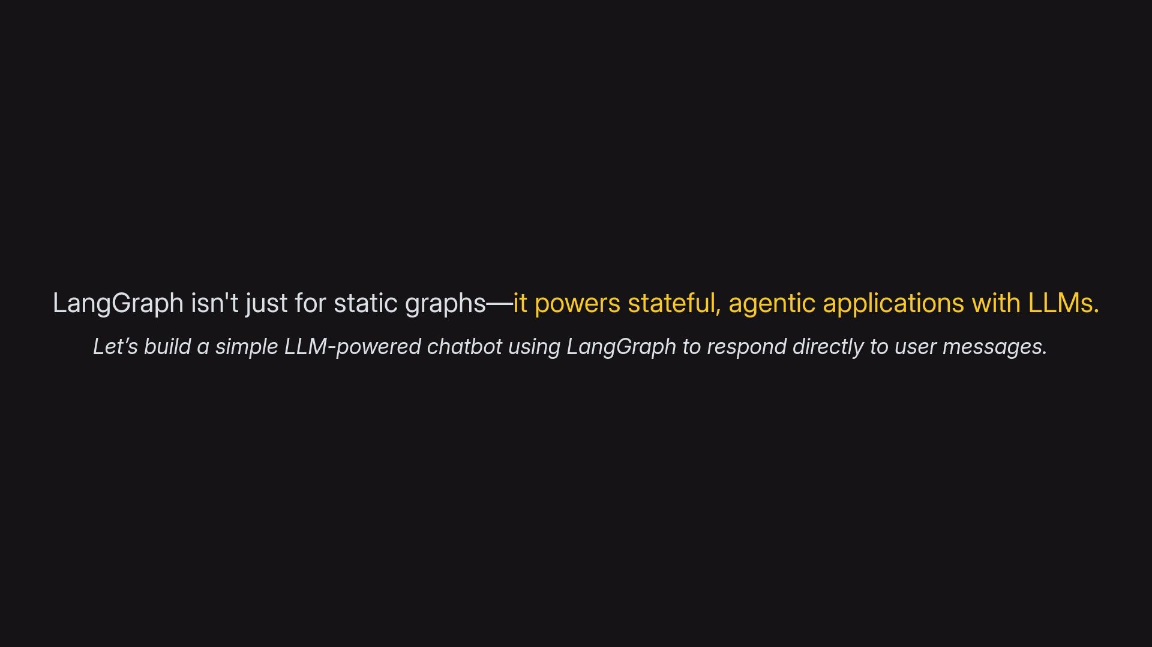

Slide 45
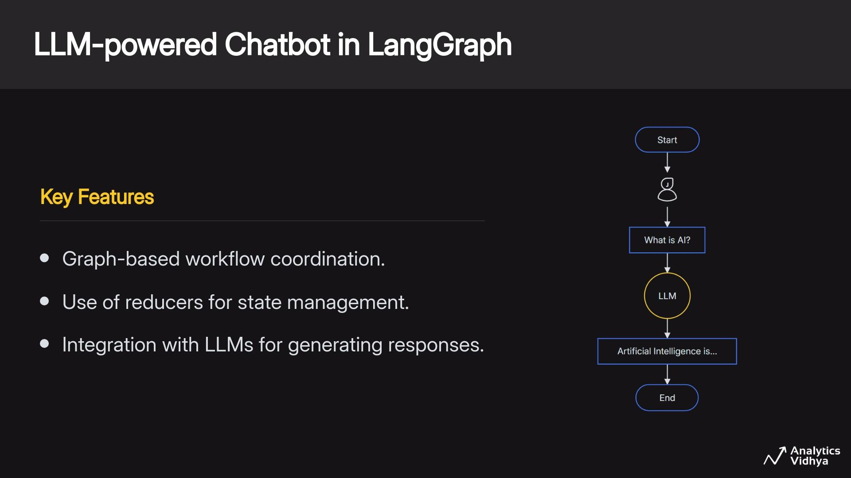

Slide 46
Live Coding - Session 3
Build a LLM-powered Chatbot in LangGraph
Get the notebook from HERE
Run it on Colab by copying to your drive or local system & follow along with the instructor
Recommended to run on Google Colab

Slide 47
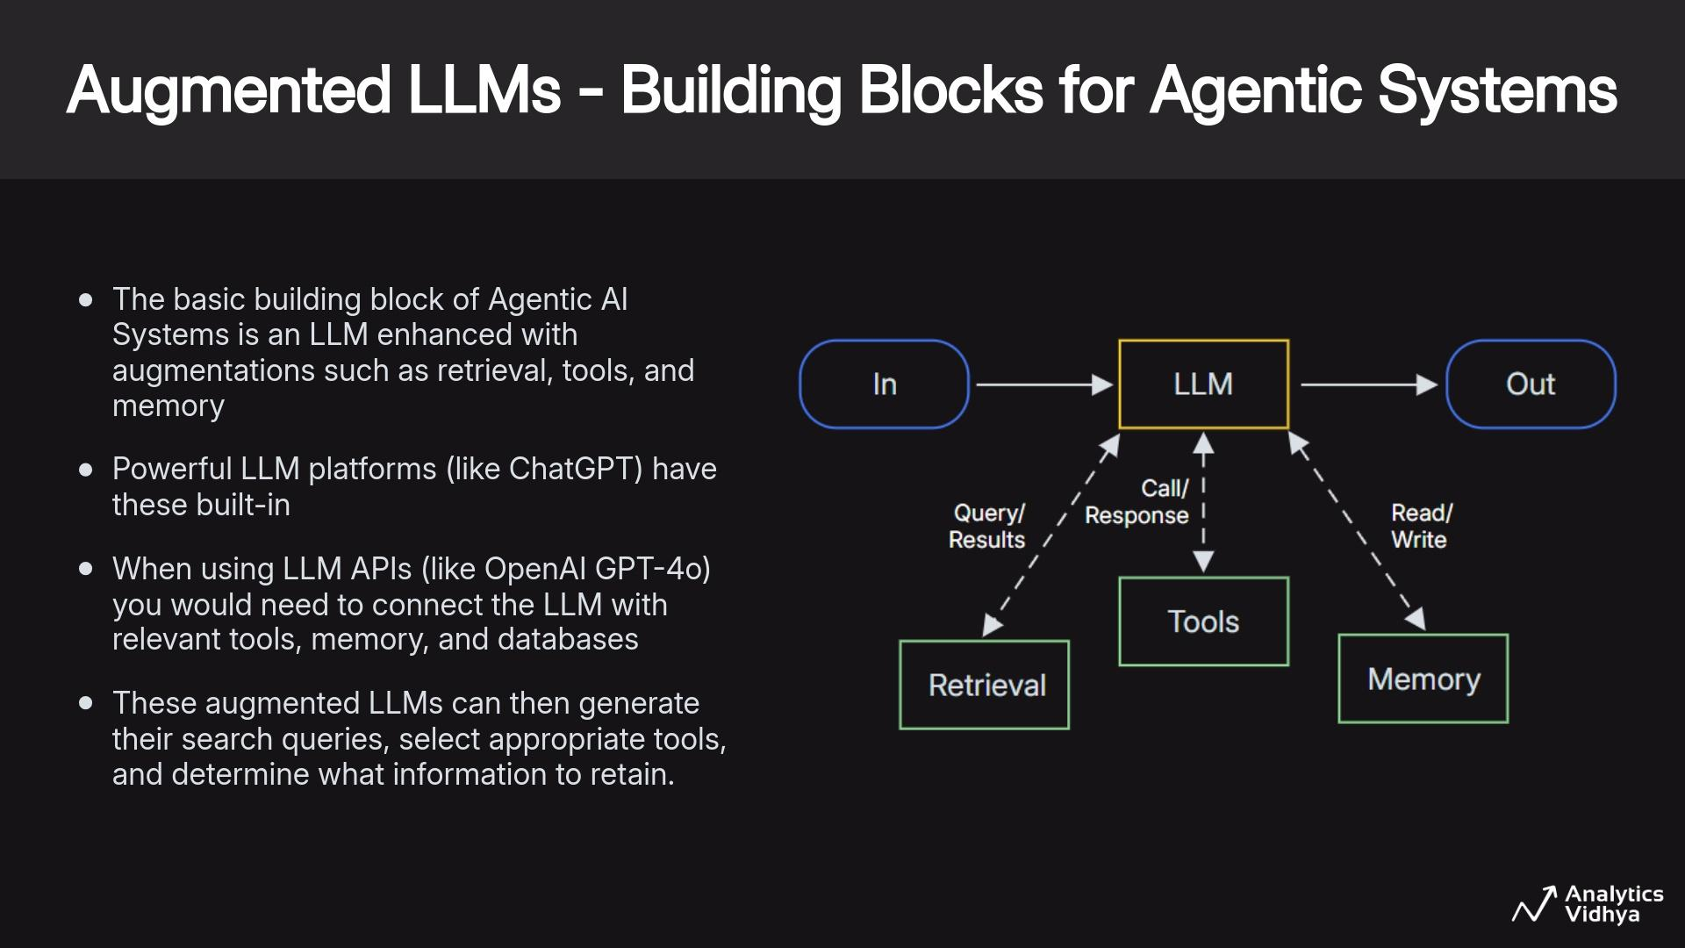

Slide 48
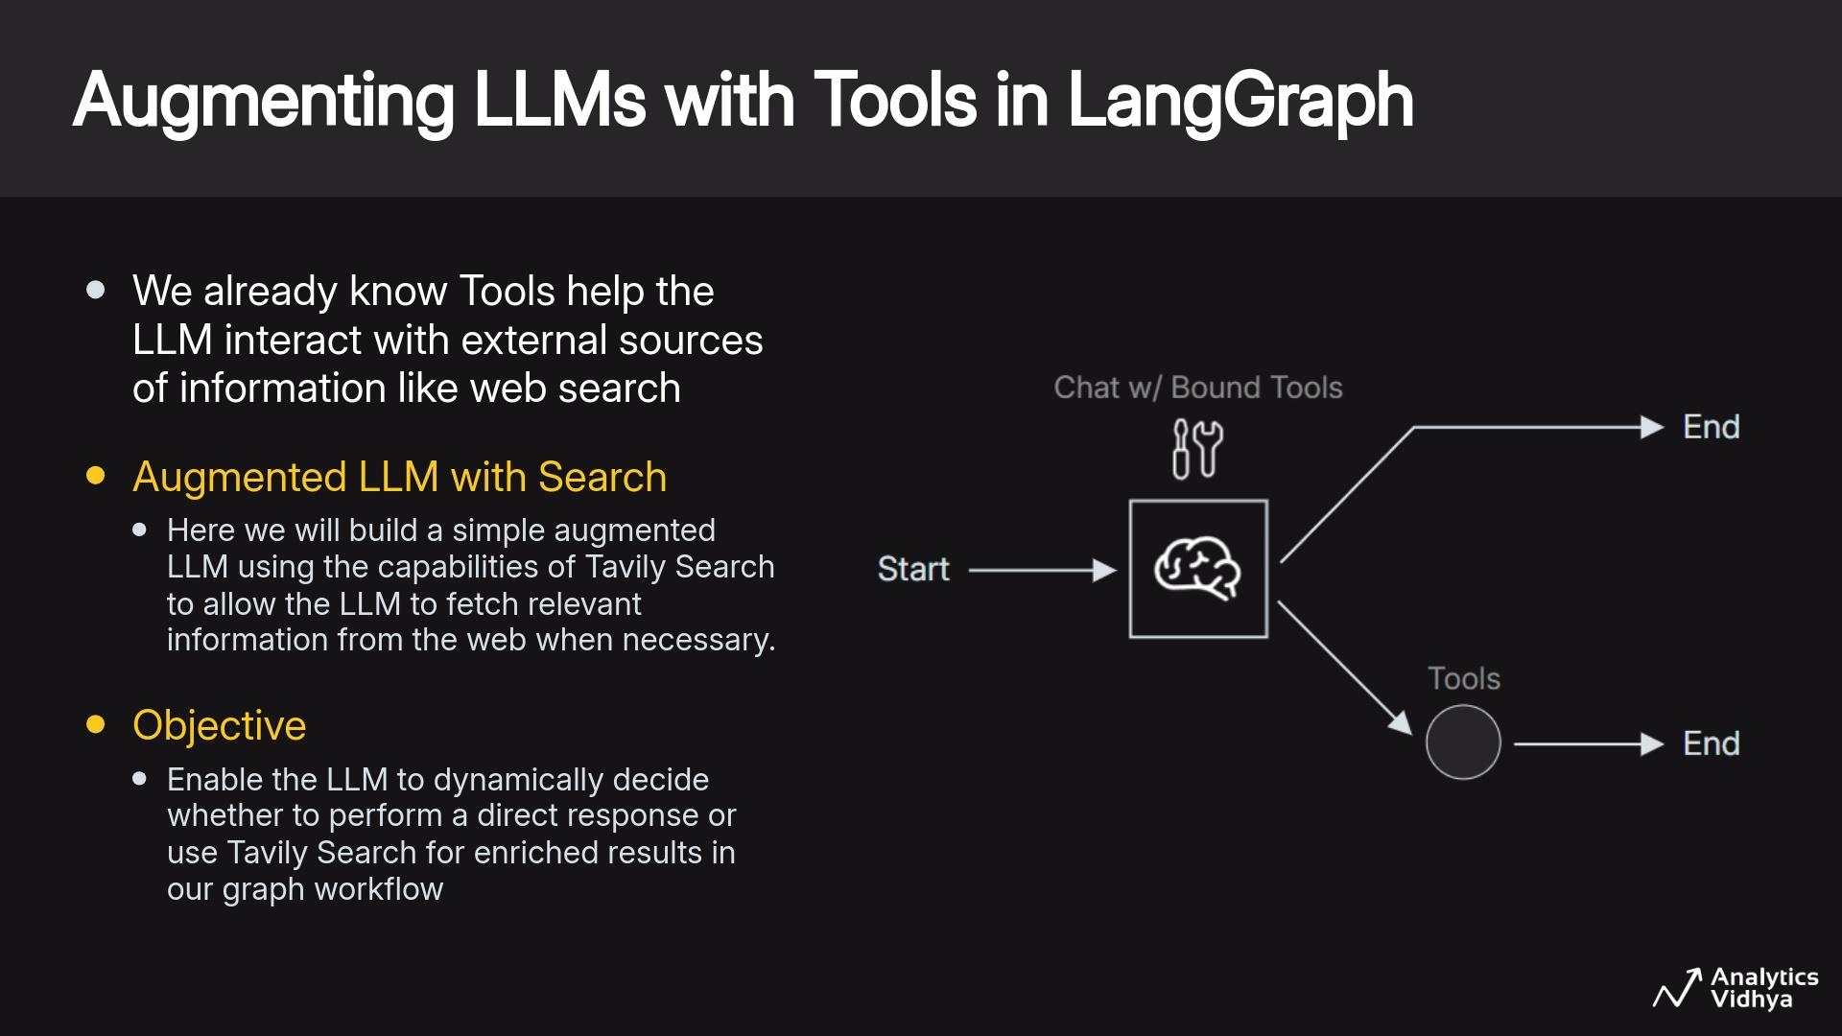

Slide 49
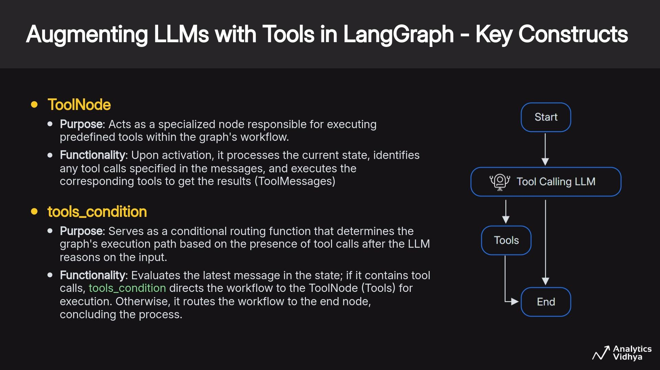

Slide 50
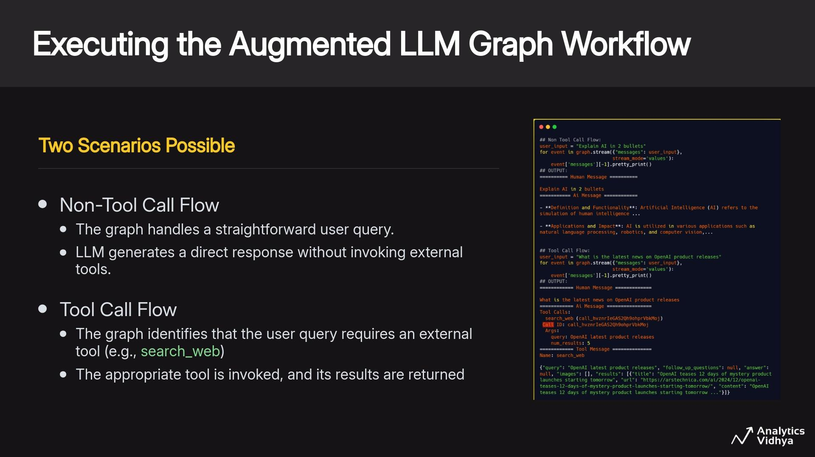

Slide 51
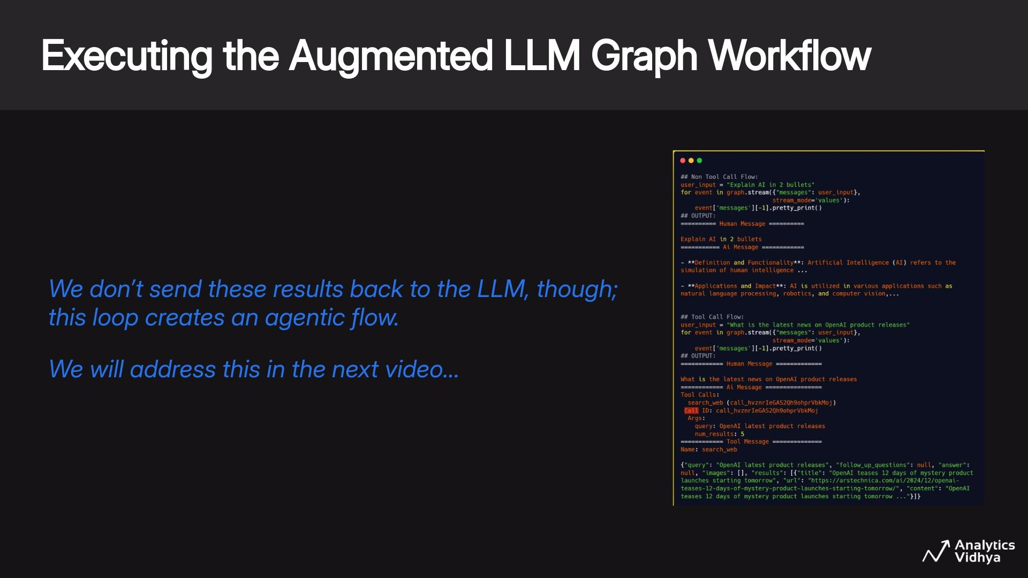

Slide 52
Live Coding - Session 4
Build a LLM-powered Chatbot in LangGraph
Get the notebook from HERE
Run it on Colab by copying to your drive or local system & follow along with the instructor
Recommended to run on Google Colab

Slide 53
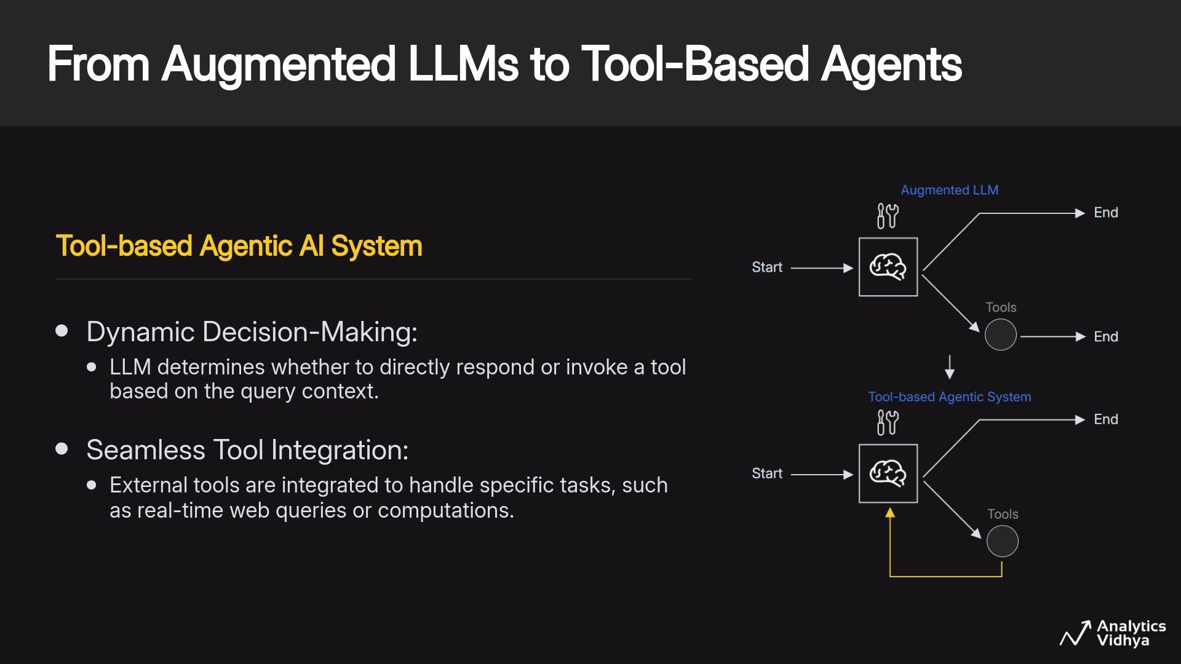

Slide 54
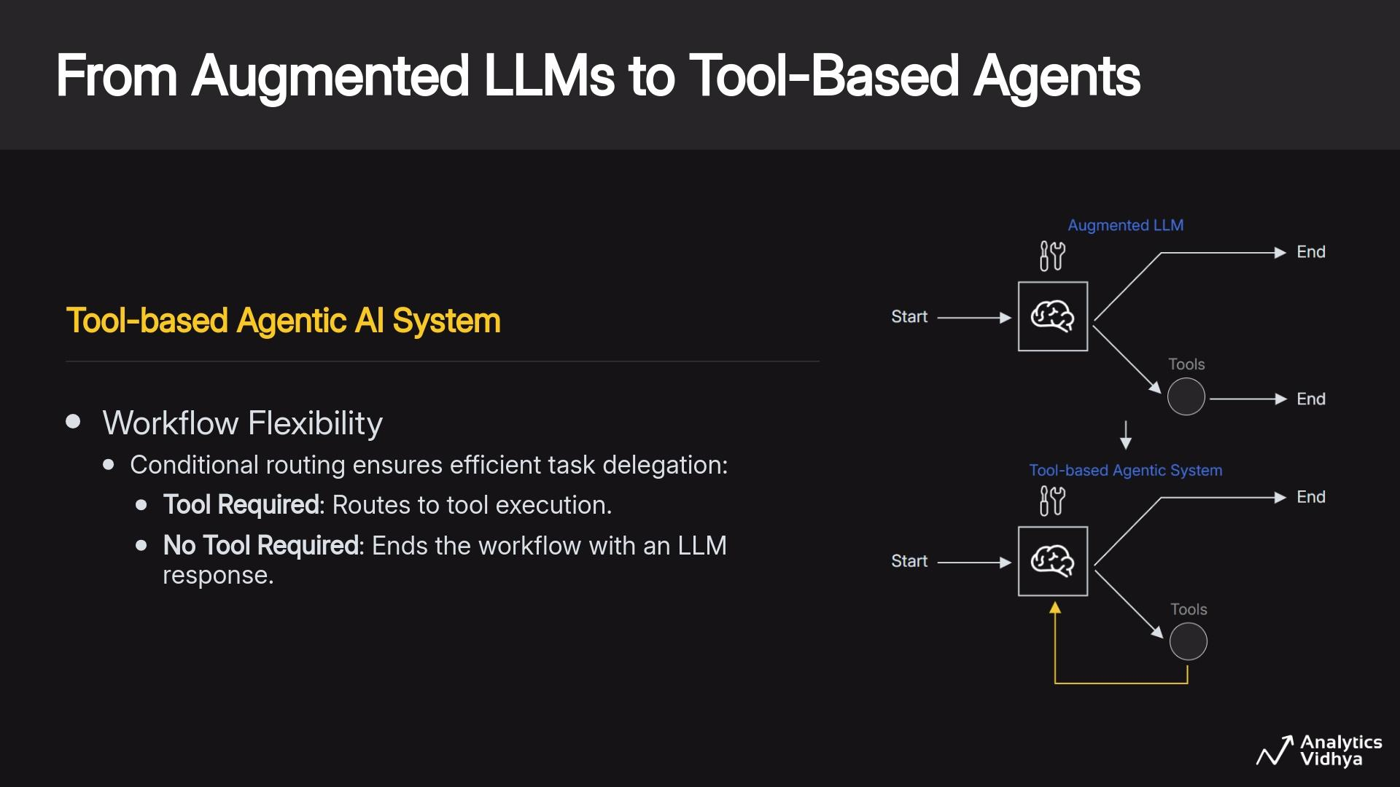

Slide 55
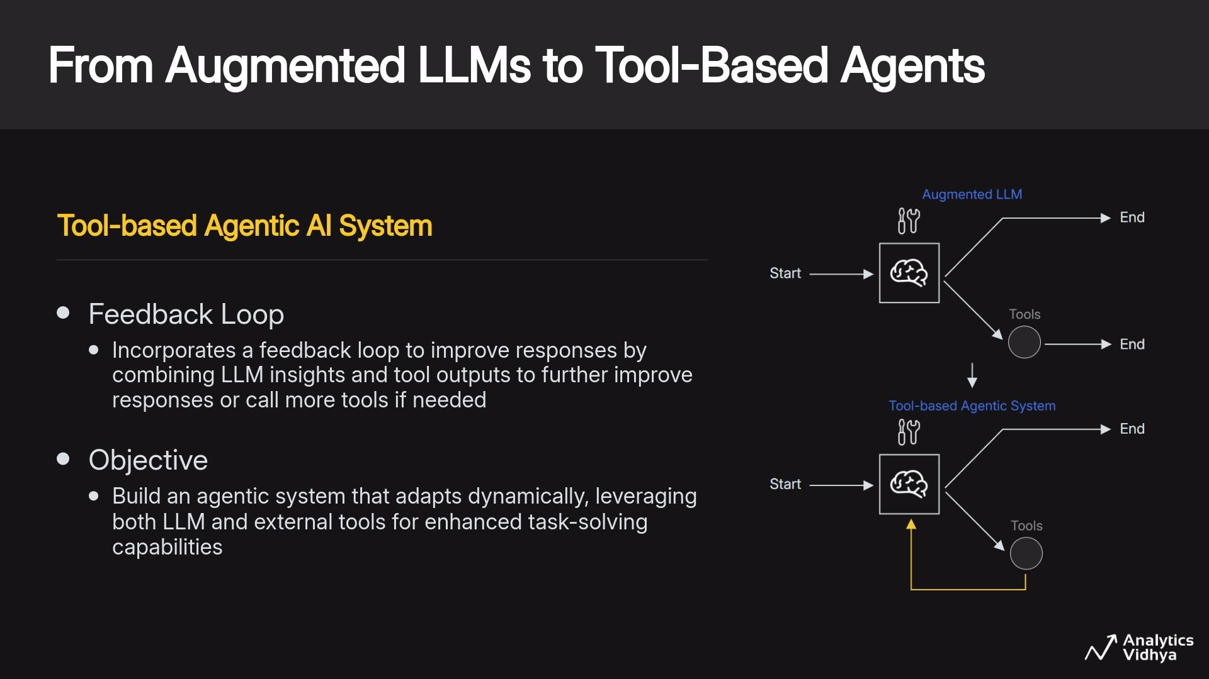

Slide 56
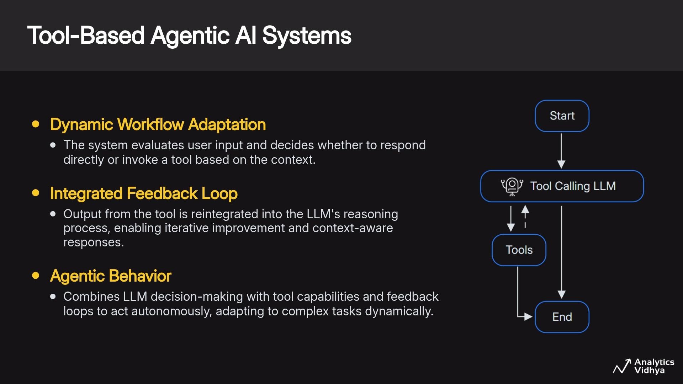

Slide 57


Slide 58


Slide 59
Live Coding - Session 5
Build a LLM-powered Chatbot in LangGraph
Get the notebook from HERE
Run it on Colab by copying to your drive or local system & follow along with the instructor
Recommended to run on Google Colab

